Slide 1
Behavioral Robustness of Software System Designs
Changjian Zhang
Thesis Committee:
Eunsuk Kang (Co-Chair) David Garlan (Co-Chair)
Jonathan Aldrich Sebastian Uchitel (Imperial College and Universidad de Buenos Aires)

Slide 2
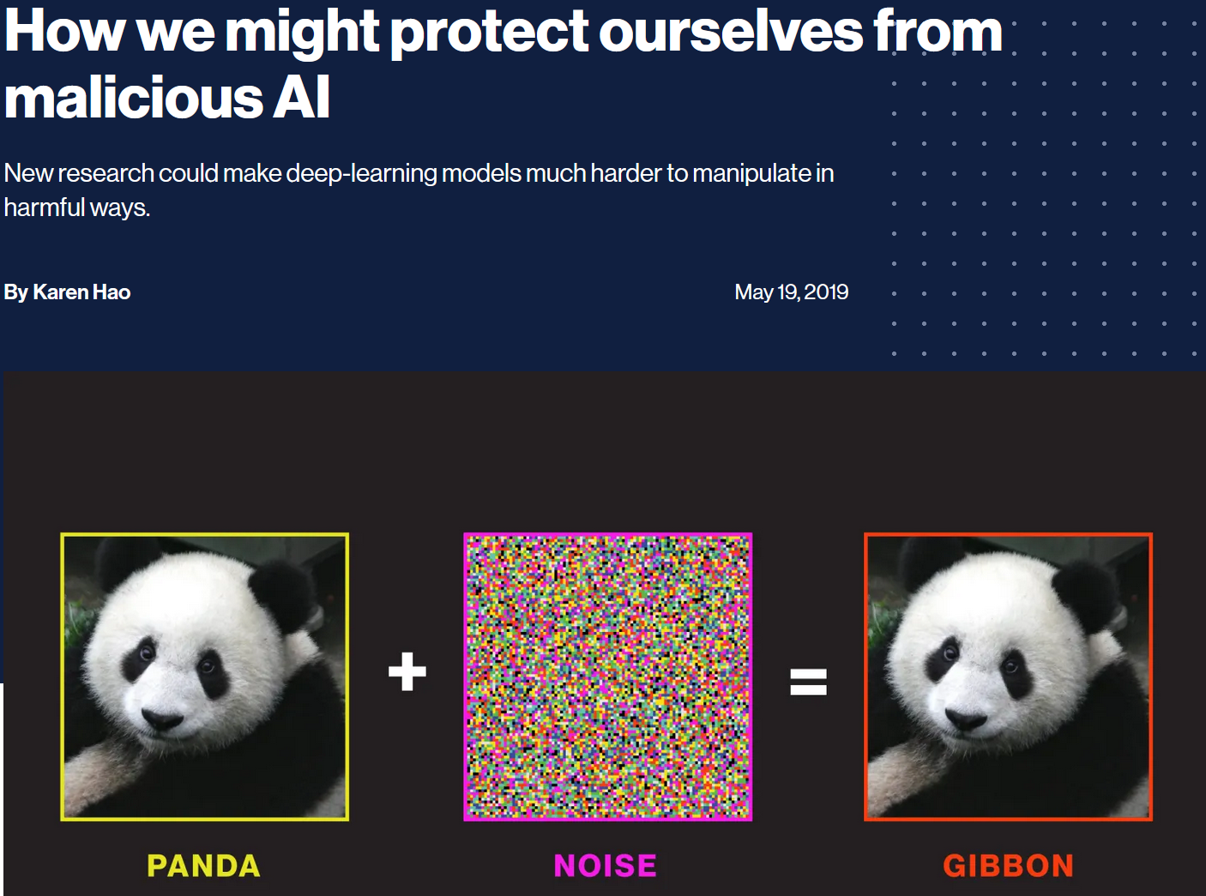
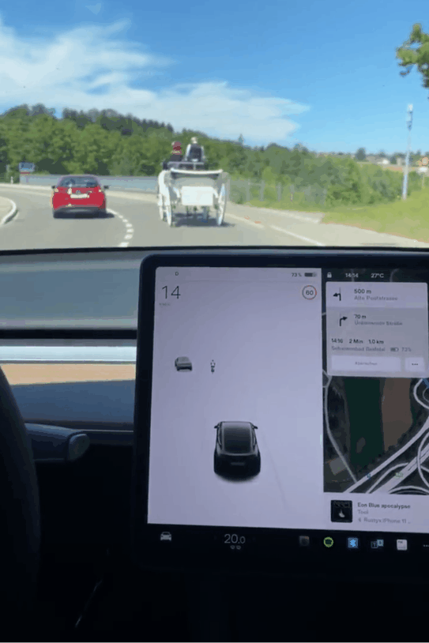
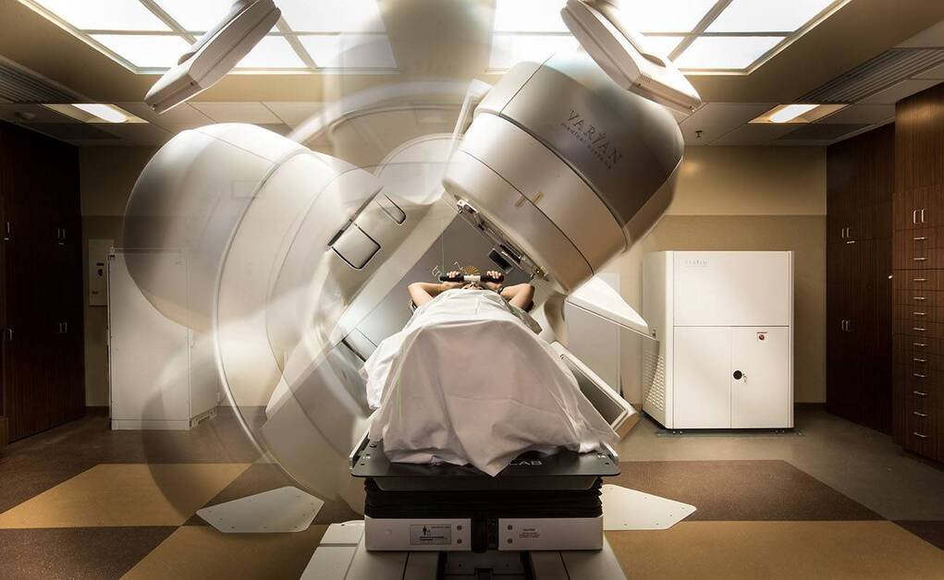
A Thesis about Software Robustness
Introduction | Related Work | Thesis Statement | Robustness | Robustification-by-Control | Specification Weakening | Evaluation | Future Work | Conclusion
“Robustness is the ability of a software system to continue functioning correctly in the presence of invalid inputs or stressful environment.”
What is Robustness?
Notes:
According to IEEE, robustness is … But in different domains, the concrete definitions of robustness are quite different.
ML: the model produce consistent prediction given random noise or minor perturbations (pixels)
Self-driving car: guarantee safety even under inaccurate sensing
Medical device: ensure patient’s safety even under mistakes from human operators.
What is robustness we study?

Slide 3
A Categorization of Robustness
Introduction | Related Work | Thesis Statement | Robustness | Robustification-by-Control | Specification Weakening | Evaluation | Future Work | Conclusion
I/O Relation and Behavioral
Type of Systems
Input-Output Relations:
No erroneous outputs or crashes under invalid inputs (e.g., out-of-range values).
Behavior as States and Transitions:
Safety: not reaching bad states.
Liveness: reaching good states.
Maintain a property under unexpected env behavior.
Conventional Software Systems:
Discrete systems.
OS, web services, etc.
Machine Learning (ML) Systems:
Data driven, statistical model.
Cyber-Physical Systems (CPS):
Physical process + Software.
ODE, Hybrid Model
Drones, self-driving cars.
Notes:
Two dimensions: the type of properties and the type of systems.
I/O: for a function call taking input and return output, …
Behavioral: a set of execution traces, two types of prop are often used to describe the expected behavior
Conventional: traditional means of software, essentially discrete systems.
ML: systems with ML as critical components, ML models are data-drive, statistical models. Often as black boxes.
CPS: important to model the physical process, need continuous model like ODEs, Hybrid model.

Slide 4
A Categorization of Robustness
Introduction | Related Work | Thesis Statement | Robustness | Robustification-by-Control | Specification Weakening | Evaluation | Future Work | Conclusion
I/O Relation and Behavioral
Type of Systems
Input-Output Relations:
No erroneous outputs or crashes under invalid inputs (e.g., out-of-range values).
Behavior as States and Transitions:
Safety: not reaching bad states.
Liveness: reaching good states.
Maintain a property under unexpected env behavior.
Conventional Software Systems:
Discrete systems.
OS, web services, etc.
Machine Learning (ML) Systems:
Data driven, statistical model.
Cyber-Physical Systems (CPS):
Physical process + Software.
ODE, Hybrid Model
Drones, self-driving cars.
Notes:
Our focus is on behavior properties and conventional systems i.e. systems that can be modeled in discrete systems.
Also note that, the boundaries between these systems are vague. E.g., medical devices may also be considered as CPS, but in our context, we emphasize that the modeling of the physical process is critical in the CPS we refer to.
Or in other words, we deal with any system that can be represented in discrete transition systems, even if they e.g., contain ML or is also considered a CPS.

Slide 5
Our Work: Behavioral Robustness
Introduction | Related Work | Thesis Statement | Robustness | Robustification-by-Control | Specification Weakening | Evaluation | Future Work | Conclusion
System
Machine
Assumed
Env.
satisfy
Safety/Liveness Property
Deviations (Uncertainties): sequences of env events not expected.
satisfy?
Actual
Env.
Notes:
We consider behavioral robustness, for a system, it contains the behavior model of the software machine and its operating env.
Under the assumed env, the sys should satisfy some desired props in safety or liveness.
However, the actual env may be different from the assumed one, robustness studies whether the machine continue to satisfy those props
The difference between assumed and actual is called deviations or uncertainties.
In particular, we focus on one type of deviations, i.e., sequences of events not presented in assumed env.

Slide 6
Motivating Example: Therac-25
Introduction | Related Work | Thesis Statement | Robustness | Robustification-by-Control | Specification Weakening | Evaluation | Future Work | Conclusion
Notes:
We will use a therapy machine case study similar to the infamous therac-25 machine as an illustration example

Slide 7
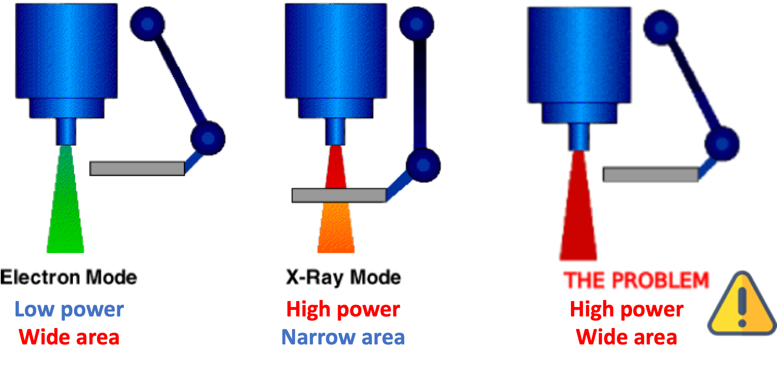
Therac-25 Machine
Introduction | Related Work | Thesis Statement | Robustness | Robustification-by-Control | Specification Weakening | Evaluation | Future Work | Conclusion
A spreader in place during X-Ray for safe radiation level.
Electron (EBeam) and X-Ray modes.
Notes:
The machine has two beam mode: Electron beam mode and X-ray mode.
The electron beam mode has low power and a wide area, and the x-ray mode has high power
In order to ensure safety, to avoid over-dose to patients, a spreader must be in place in the X-ray mode to attenuate the beam power.

Slide 8
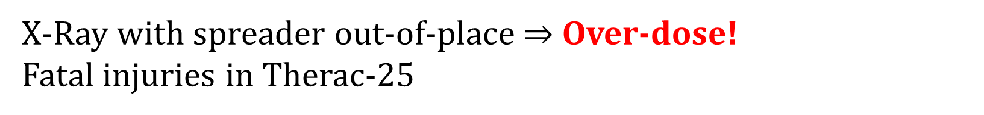
Therac-25 Safety Requirement
Introduction | Related Work | Thesis Statement | Robustness | Robustification-by-Control | Specification Weakening | Evaluation | Future Work | Conclusion
X-Ray with spreader out-of-place $⇒$ Over-dose!
Fatal injuries in Therac-25
Notes:
In other words, if the spreader is out of place in X-ray mode, it may cause over-dose.
However, the unfortunate fact is that this happened in therac-25 and caused several fatal injuries.

Slide 9


Assumed Environment and Deviations
Introduction | Related Work | Thesis Statement | Robustness | Robustification-by-Control | Specification Weakening | Evaluation | Future Work | Conclusion
Assumed Env (Operator)
Deviation
How can we build Robust-by-Design software?
Choose X-ray mode.
(Spreader moves in.)
Confirm mode.
Fire the beam.
Accidentally choose X-ray.
(Spreader moves in.)
Switch to Electron Beam.
(Spreader moves out.)
(Mode switch in progress!)
Confirm mode.
Fire X-ray without spreader.
Safe!
Unsafe and Unrobust!
Notes:
Let’s understand how this happened:
Under the assumed env, the operator follows the use instruction…
A deviation in env could be: the operator accidentally …
In the deviated env, the machine is unsafe. So we say it is not robust against this deviation.
So the goal of this research is to investigate: how can we …

Slide 10



Robust-by-Design Software
Introduction | Related Work | Thesis Statement | Robustness | Robustification-by-Control | Specification Weakening | Evaluation | Future Work | Conclusion
Assessment: Methods to systematically compute robustness.
Design
Robustness
Analysis
Developer, Designer,
Architect
Improvement: Methods to systematically improve the robustness of a design.
Robustify
Design
Notes:
We consider a robust-by-design development process.
In this process, developers start with an initial design,
Then, they can compute the robustness of the machine
If the machine is not robust enough, then they can choose to robustify the design, i.e., making it more robust
This can be iterated for multiple times until a satisfactory machine is found.
To achieve this process, we need: …

Slide 11
Gaps in Robustness Assessment
Introduction | Related Work | Thesis Statement | Robustness | Robustification-by-Control | Specification Weakening | Evaluation | Future Work | Conclusion
Existing works mostly focus on testing against implementation.
Fault injection, model-based testing, fuzzing, …
Wrong outputs or crashes.
Design
Robustness
Analysis
Developer, Designer,
Architect
Robustify
Design
Notes:
Existing work in robustness assessment:
In particular, most of them focus on I/O robustness, i.e., given invalid inputs whether …
Q: what guarantees do other methods provide? Counterexamples, but no guarantee on no counterexmaples. But one limitation of these methods is that they don’t provide formal guarantees, i.e., it is hard to tell whether we can confidently say a machine is robust against all possible deviations or we need more tests.

Slide 12
Gaps in Robustness Improvement
Introduction | Related Work | Thesis Statement | Robustness | Robustification-by-Control | Specification Weakening | Evaluation | Future Work | Conclusion
Implementation improvement:
Wrapper of code.
Defensive programming, Clean Code, Effective Java, …
Self-adaptive system and Runtime assurance:
Focus on run-time.
Improve “robustness” implicitly.
Architecture tactics:
SEI robustness report.
Design
Robustness
Analysis
Developer, Designer,
Architect
Robustify
Design
Notes:
Traditional robustness improvement techniques also focus more on implementation.
Build wrapper over existing code to filter out invalid inputs and outputs; advocate the use of best programming practices like…
On the other hand, work from self-adaptive and runtime assurance are more closely related to our notion of robustness.
They also consider the behavior of the system, and many of their methods can improve robustness even though the term robustness may not be explicitly used.
Also, we focus on safety and liveness, but they are also interested in a broader set of props, like …
In addition, other than robustness, they also consider recoverability, i.e., to allow the system degrade under deviations but then recover from them.
Lastly, there work of robustness from an architecture perspective, like SEI… However, they are very high-level guidance on design
Does not offer direct solution (a new design) for how to improve the robustness of a particular system.

Slide 13
Our Goal: Formal Analysis and Improvement of Behavioral Robustness
Introduction | Related Work | Thesis Statement | Robustness | Robustification-by-Control | Specification Weakening | Evaluation | Future Work | Conclusion
RQ: Can we systematically compute behavioral robustness of a machine design?
Design
Robustness
Analysis
Developer, Designer,
Architect
RQ: Can we rigorously and systematically improve the behavioral robustness of a machine design?
Robustify
Design
Notes:
So the goal of this thesis is to study fill the gap of…

Slide 14
Thesis Statement
Introduction | Related Work | Thesis Statement | Robustness | Robustification-by-Control | Specification Weakening | Evaluation | Future Work | Conclusion
Given a machine and its environment that can be formally modeled as a state-transition system, we can systematically compute and improve the behavioral robustness of the machine with respect to the environment and a system-level safety property.
Notes:
And my thesis statement is …

Slide 15



Contributions Overview
Introduction | Related Work | Thesis Statement | Robustness | Robustification-by-Control | Specification Weakening | Evaluation | Future Work | Conclusion
A behavioral notion of robustness based on LTS and its computation method.
Contrib. 1
Initial
Requirements
Robust
Enough?
Yes
Robustness
Analysis
(In)Tolerable
Deviations
Final
Design
Design
Specification
Notes:
Here, I show the overview of my contributions.
Given an initial set of requirement and an initial design, we first propose ..
And present a way to compute

Slide 16
Contributions Overview
Introduction | Related Work | Thesis Statement | Robustness | Robustification-by-Control | Specification Weakening | Evaluation | Future Work | Conclusion
A behavioral notion of robustness based on LTS and its computation method.
Contrib. 1
Initial
Requirements
Robust
Enough?
Yes
Robustness
Analysis
(In)Tolerable
Deviations
Final
Design
Design
Specification
No
Contrib. 2
Improve robustness by generating a controller w.r.t. the safety property.
Robustification
by Control
Notes:
If developers find the design is not robust enough, we propose a way to robustify the machine against the safety prop by leveraging control theory.
However, this method may not always give satisfactory results.
One situation is that the safety prop conflicts with the functional requirements
In particular, when the safety prop is too restrictive.

Slide 17
Contributions Overview
Introduction | Related Work | Thesis Statement | Robustness | Robustification-by-Control | Specification Weakening | Evaluation | Future Work | Conclusion
A behavioral notion of robustness based on LTS and its computation method.
Contrib. 1
Initial
Requirements
Robust
Enough?
Yes
Robustness
Analysis
(In)Tolerable
Deviations
Final
Design
Design
Specification
No
Weaken the safety property to maintain more system functionality.
Contrib. 2
No
Requirements
Conflicts?
Improve robustness by generating a controller w.r.t. the safety property.
Robustification
by Control
Yes
Contrib. 3
Specification
Weakening
Resolved
Requirements
Notes:
Therefore, we then present a method to weaken the safety prop
So that by using this weakened prop, re-running the control method can generate more satisfactory solution.
And developers can then reanalyze the robustness of the new design.

Slide 18
Contributions Overview
Introduction | Related Work | Thesis Statement | Robustness | Robustification-by-Control | Specification Weakening | Evaluation | Future Work | Conclusion
A behavioral notion of robustness based on LTS and its computation method.
Contrib. 4: tool Fortis
Contrib. 1
Initial
Requirements
Robust
Enough?
Yes
Robustness
Analysis
(In)Tolerable
Deviations
Final
Design
Design
Specification
No
Weaken the safety property to maintain more system functionality.
Contrib. 2
No
Requirements
Conflicts?
Improve robustness by generating a controller w.r.t. the safety property.
Robustification
by Control
Yes
Contrib. 3
Specification
Weakening
Resolved
Requirements
Notes:
Finally, for all our proposed techniques, we implement them in a tool Fortis.
And we evaluate the applicability and performance of our techniques.

Slide 19
Robustness Analysis
…, we can systematically measure and improve the behavioral robustness …
A formal, behavioral notion of robustness.
Robustness computation and representation.
Notes:
This part I’ll describe how we define behavior robustness and compute it.

Slide 20
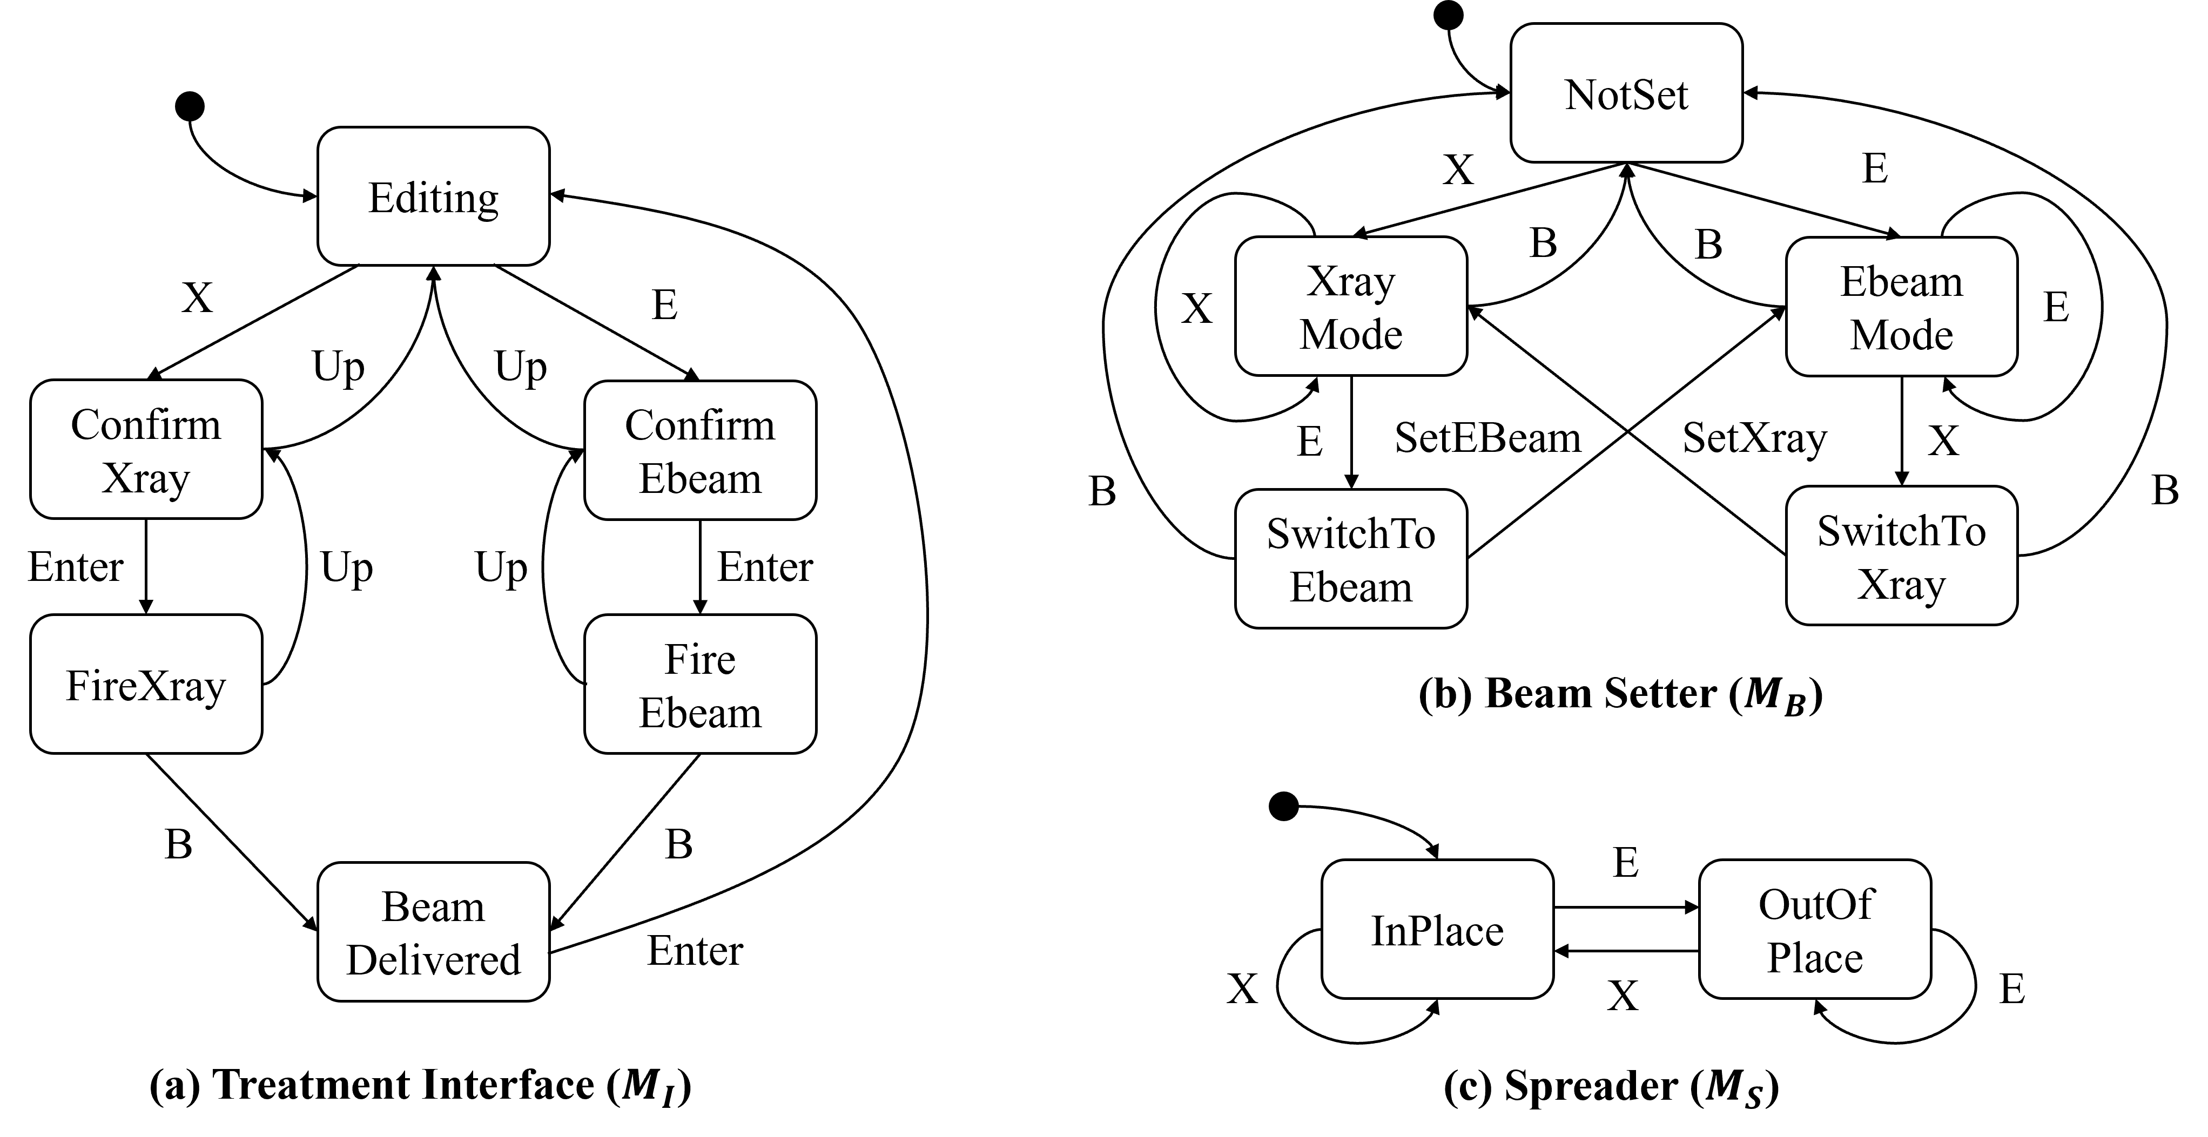
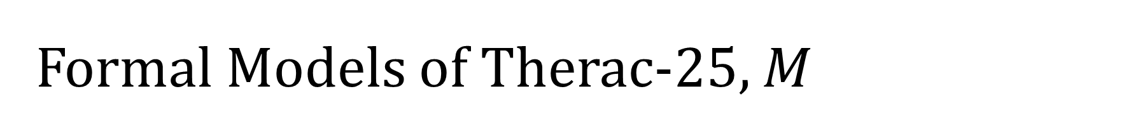
Formal Models of Therac-25, $M$
Introduction | Related Work | Thesis Statement | Robustness | Robustification-by-Control | Specification Weakening | Evaluation | Future Work | Conclusion
Notes:
We use LTS to model the behavior of the system. Essentially, LTS is a state machine
On the left, it shows the model of the treatment interface. An operator can …
On the right, it shows the other two modules of the machine.
It has a beam setter module which controls the switching between radiation mode.
Also, a spreader module which models the position of the spreader.
One thing to note is that, the mode switching will take a long time to complete, so we model two intermediate transition states.
And this may cause overdose or underdose situations.

Slide 21
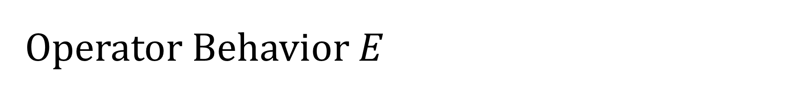
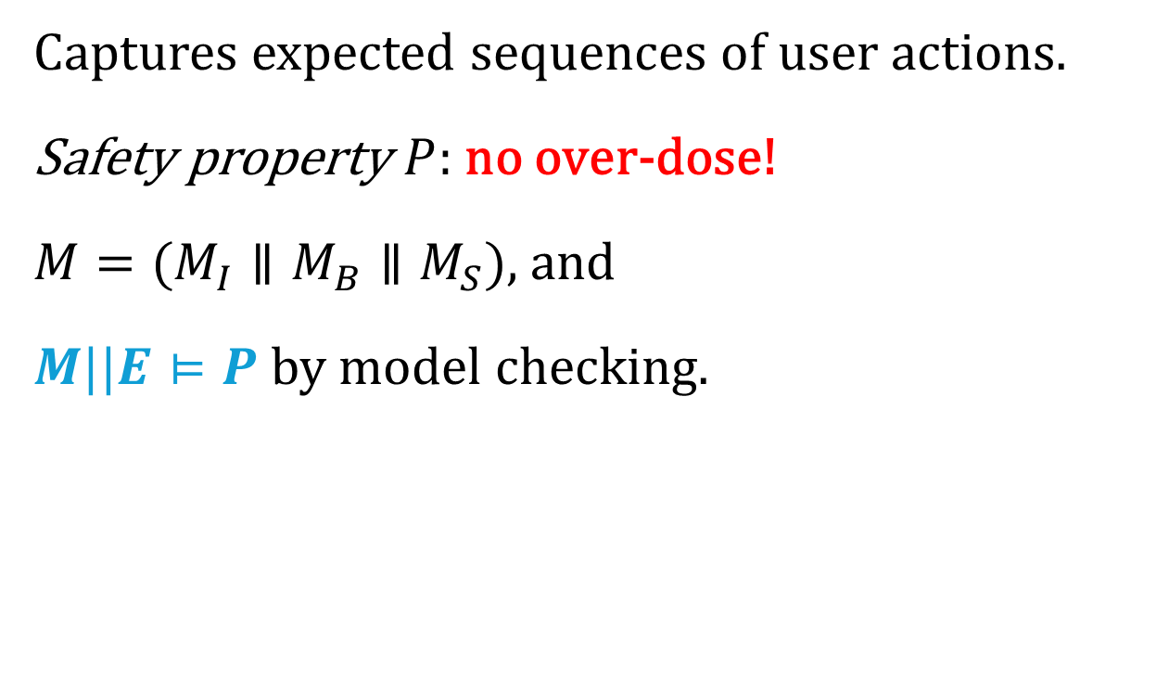
Operator Behavior $E$
Introduction | Related Work | Thesis Statement | Robustness | Robustification-by-Control | Specification Weakening | Evaluation | Future Work | Conclusion
Select Mode
Captures expected sequences of user actions.
Safety property $P$: no over-dose!
$M=(M_{I}∥M_{B}∥M_{S})$, and
$M||E⊨P$ by model checking.
X
E
Confirm Mode
Enter
Fire Beam
B
Task Complete
Notes:
We also need the model of the env. In this example, it is the expected behavior of the operator.
The model on the left shows the operator model, they can …
And we have the safety prop to ensure there should be no over-dose to the patients.
Our assumption is that, the machine should satisfy the desired property given the assumed env.
We can use a technique like model checking to assert the our machine model with this assumed env model can satisfy our no over-dose safety requirement.

Slide 22
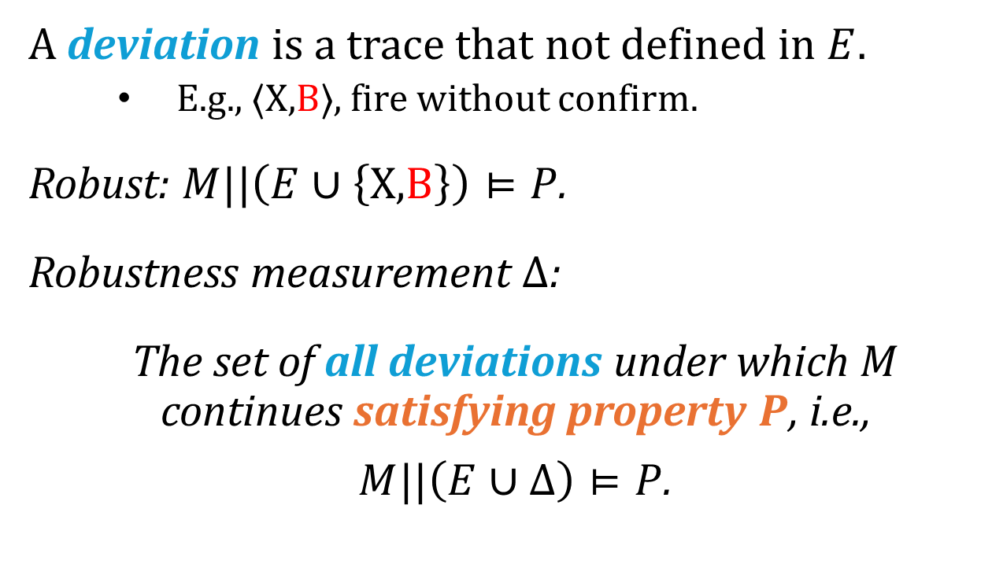
Deviation and Robustness
Introduction | Related Work | Thesis Statement | Robustness | Robustification-by-Control | Specification Weakening | Evaluation | Future Work | Conclusion
Select Mode
A deviation is a trace that not defined in $E$.
E.g., $⟨\text{X}\text{,}\text{B}⟩$, fire without confirm.
Robust: $M||\left(E∪\left\{\text{X}\text{,}\text{B}\right\}\right)⊨P$.
Robustness measurement $Δ$:
The set of all deviations under which $M$ continues satisfying property $P$, i.e.,
$M||\left(E∪Δ\right)⊨P$.
X
E
Confirm Mode
Enter
Fire Beam
B
B
Task Complete
Notes:
Then, in our work, a deviation is a trace…
E.g., we can consider a trace X, B, i.e., fire without confirm, which is not defined in the assumed env
We say the machine is robust against this deviation when it can continue satisfying the prop under the deviation
E.g., by using model checking, we can also tell that the machine is robust against X, B.
Therefore, we measure robustness as…

Slide 23
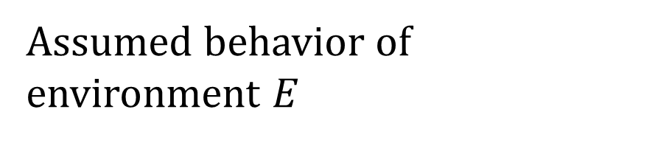
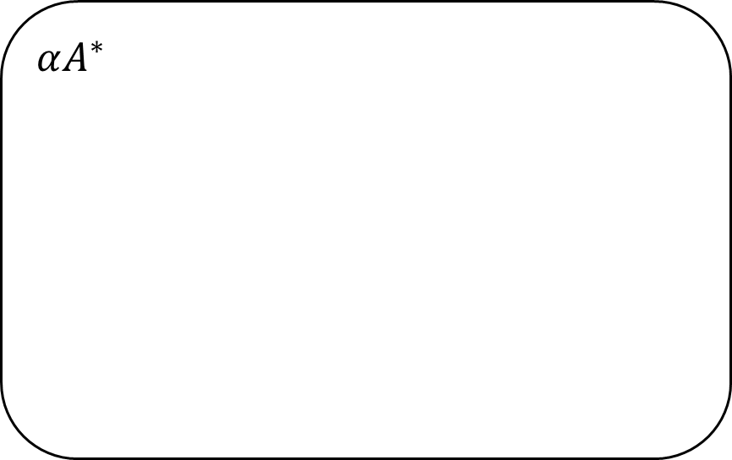
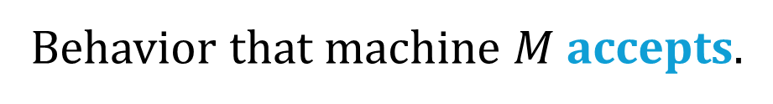
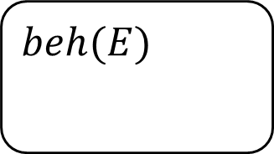
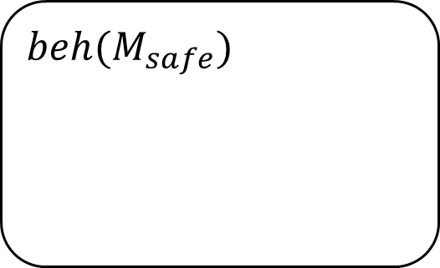
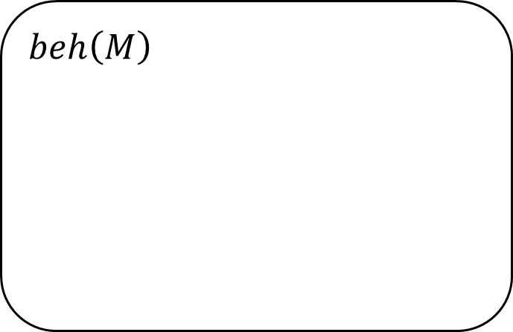
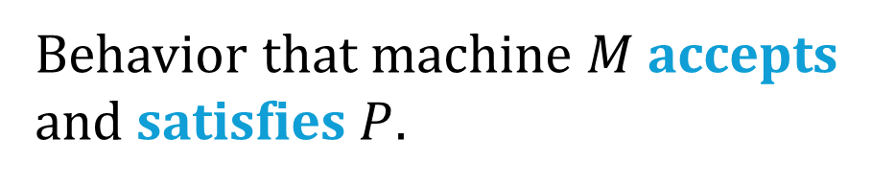
Robustness Computation
Introduction | Related Work | Thesis Statement | Robustness | Robustification-by-Control | Specification Weakening | Evaluation | Future Work | Conclusion
$$αA^{∗}$$
Behavior that machine $M$ accepts.
$$beh\left(M\right)$$
$$beh(M_{safe})$$
Behavior that machine $M$ accepts and satisfies $P$.
$$beh(E)$$
Assumed behavior of environment $E$
Notes:
Then, we show how we compute robustness
To visualize this, on this diagram, the outerbox is the set of all behaviors given some alphabet A.
The inner small box is the assumed behavior of the env.
The box in the middle is the behavior that the machine accepts.
In addition, we consider the box M_safe is the behavior that the machine accepts and also satisfies the prop P.

Slide 24
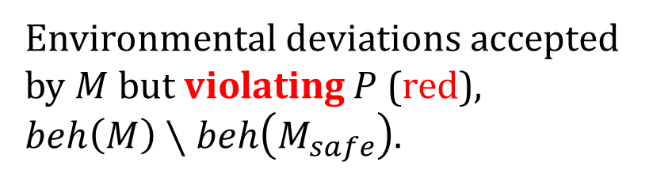
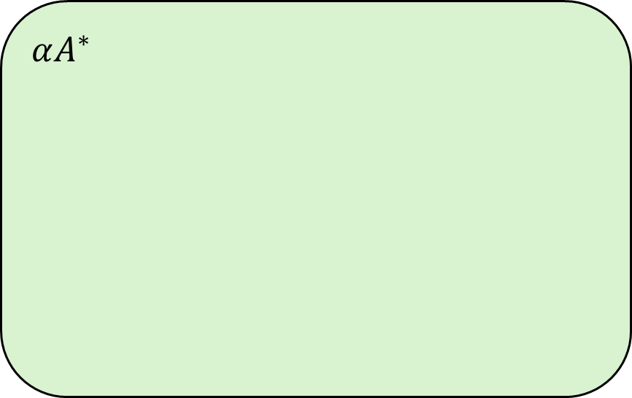
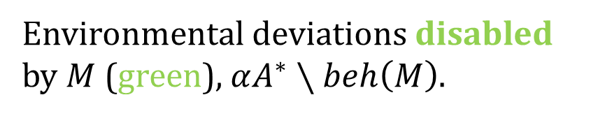
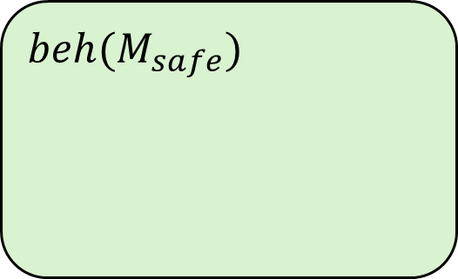
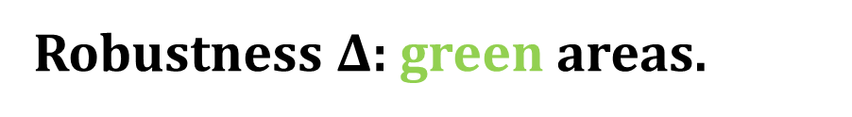
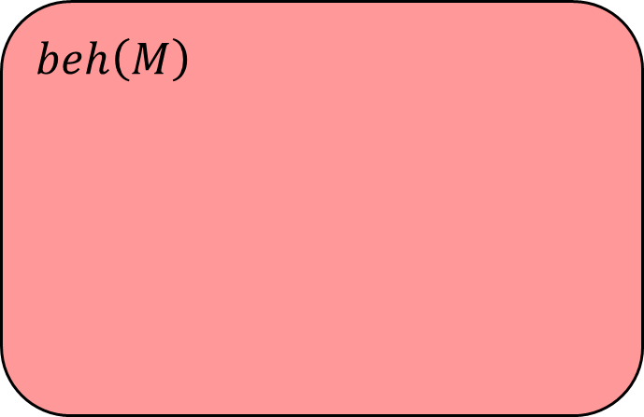
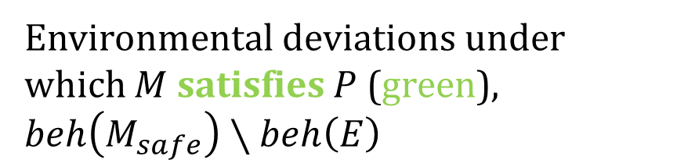
Robustness Computation
Introduction | Related Work | Thesis Statement | Robustness | Robustification-by-Control | Specification Weakening | Evaluation | Future Work | Conclusion
Environmental deviations disabled by $M$ (green), $αA^{∗}∖beh\left(M\right)$.
$$αA^{∗}$$
$$beh\left(M\right)$$
Environmental deviations accepted by $M$ but violating $P$ (red), $beh\left(M\right)∖beh\left(M_{safe}\right)$.
$$beh(M_{safe})$$
$$beh(E)$$
Environmental deviations under which $M$ satisfies $P$ (green), $beh\left(M_{safe}\right)∖beh\left(E\right)$
Robustness $Δ$: green areas.
Notes:
So first, for the inner green area, these are the deviations that M accepts and satisfy P.
Then, the red area is the middle, these are the deviations that M accepts but violate P.
Finally, the outer green area, these are deviations that M does not accept, or in other words, disabled by M.
Recall that robustness is the set of all deviations that the machine can continue satisfy the prop.
Given this definition, the robustness should be the union of the two green areas.

Slide 25
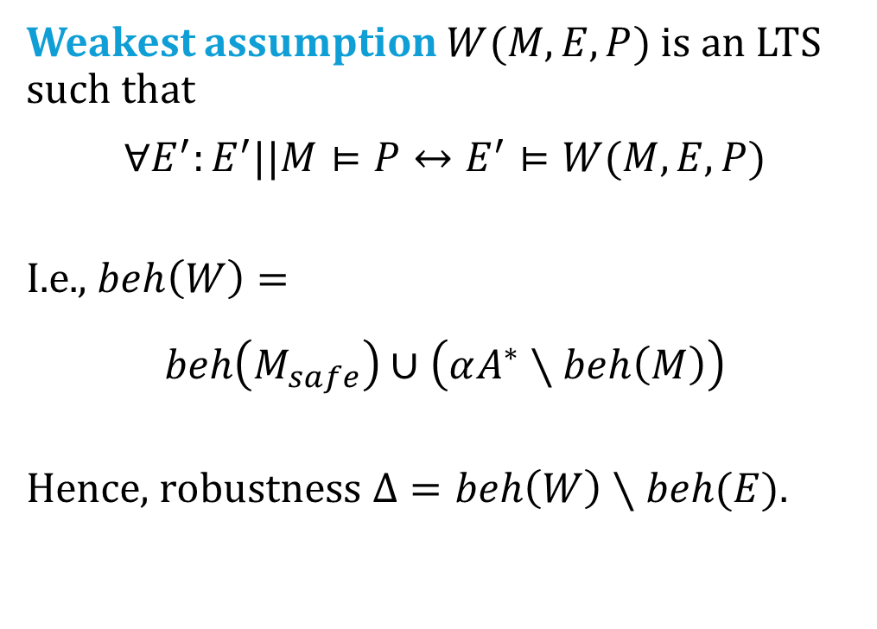
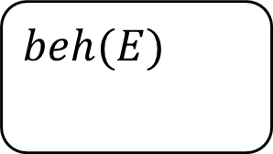
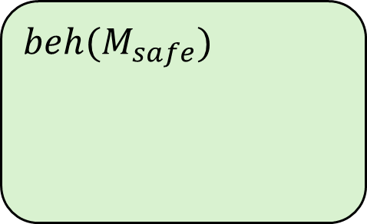
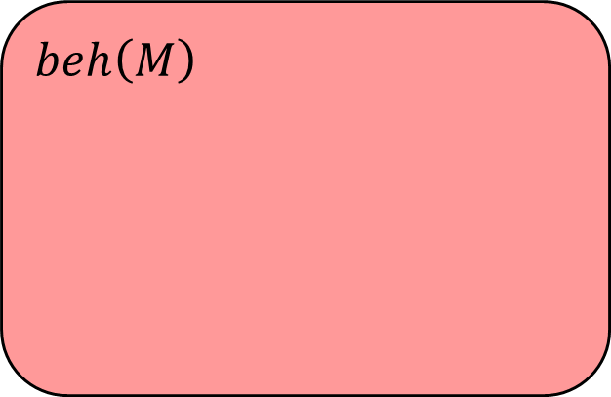
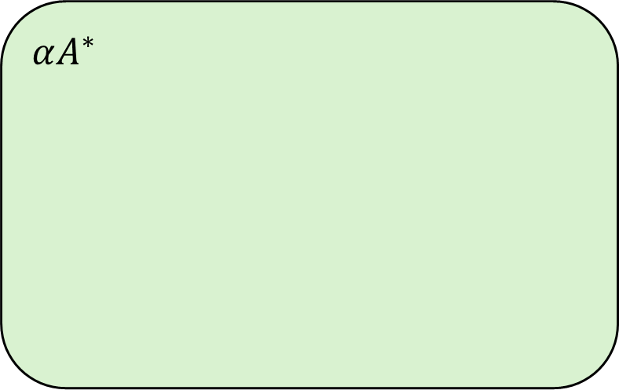
Robustness and Weakest Assumption
Introduction | Related Work | Thesis Statement | Robustness | Robustification-by-Control | Specification Weakening | Evaluation | Future Work | Conclusion
Weakest assumption $W(M,E,P)$ is an LTS such that
$$∀E^{′}:E^{′}||M⊨P↔E^{′}⊨W(M,E,P)$$
I.e., $beh\left(W\right)=$
$$beh\left(M_{safe}\right)∪\left(αA^{∗}∖beh\left(M\right)\right)$$
Hence, robustness $Δ=beh\left(W\right)∖beh(E)$.
$$αA^{∗}$$
$$beh\left(M\right)$$
$$beh(M_{safe})$$
$$beh(E)$$
Assumption generation for software component verification. D. Giannakopoulou, C. S. Pasareanu, and H. Barringer. (ASE 2002)
Notes:
To compute robustness, we then leverage the idea of weakest assumption
By definition, given a prop P, it is the maximum set of traces that the machine can satisfy the prop P.
So, the behavior of the weakest assumption equals to the beh of M_safe (the inner green area with env E) plus the beh disabled by M (the outer green area).
So robustness can be computed by the weakest assumption minus the assumed env.
In particular, we leverage Dimitra’s work to generate weakest assumption.
Q: Different from the FSE paper? Yes, disabled vs undefined

Slide 26
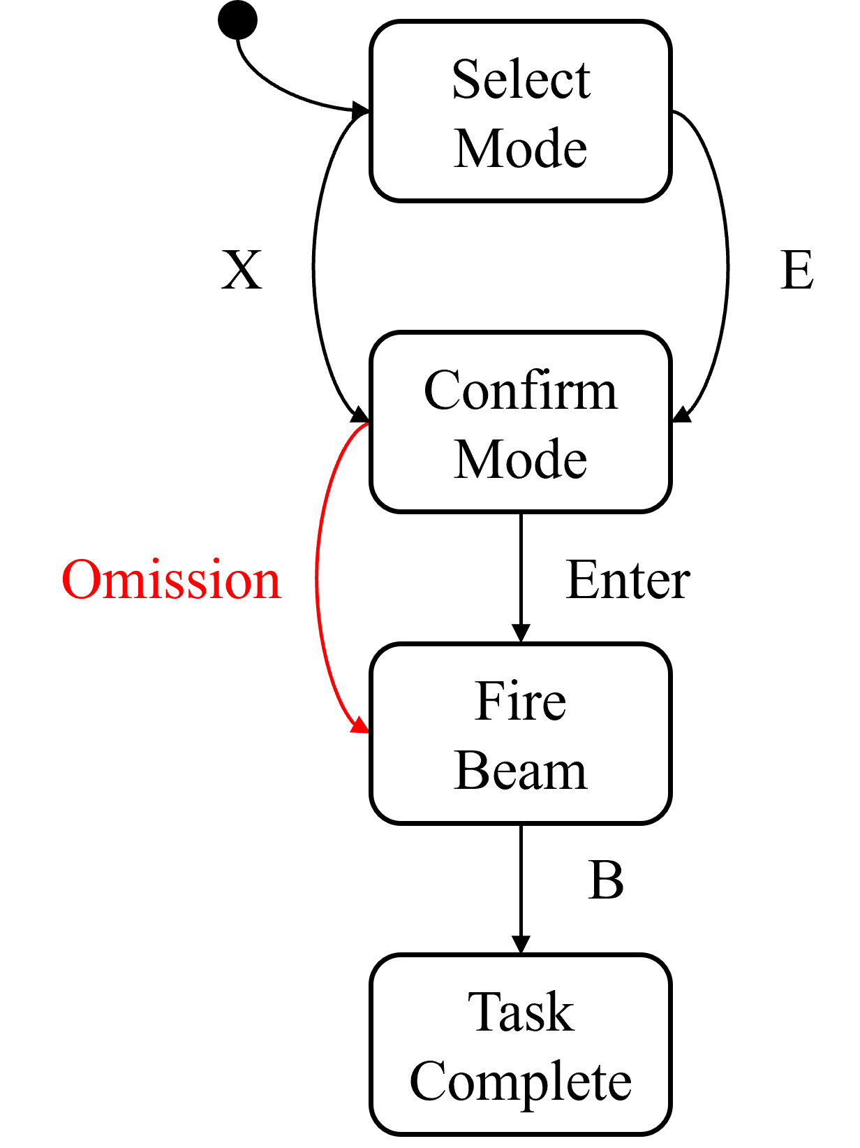
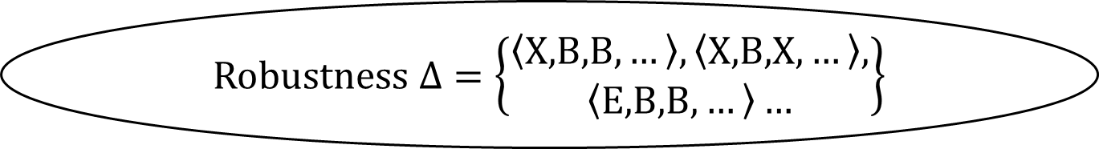
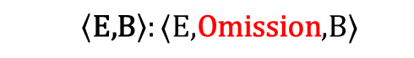

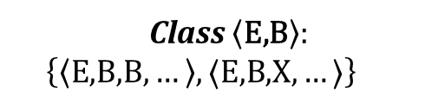
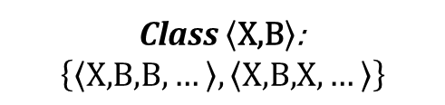
Robustness Representation and Explanation
Introduction | Related Work | Thesis Statement | Robustness | Robustification-by-Control | Specification Weakening | Evaluation | Future Work | Conclusion
Robustness $Δ=\left\{\begin{aligned}\left\langle \text{X}\text{,}\text{B}\text{,}\text{B},…\right\rangle ,\left\langle \text{X}\text{,}\text{B}\text{,}\text{X},…\right\rangle , \\ \left\langle \text{E}\text{,}\text{B}\text{,}\text{B},…\right\rangle …\end{aligned}\right\}$
Deviation Model
Extract equivalence classes
Class $\left\langle \text{X}\text{,}\text{B}\right\rangle$:
$$\left\{\left\langle \text{X}\text{,}\text{B}\text{,}\text{B},…\right\rangle ,\left\langle \text{X}\text{,}\text{B}\text{,}\text{X},…\right\rangle \right\}$$
Class $\left\langle \text{E}\text{,}\text{B}\right\rangle :$
$$\left\{\left\langle \text{E}\text{,}\text{B}\text{,}\text{B},…\right\rangle ,⟨\text{E}\text{,}\text{B}\text{,}\text{X},…⟩\right\}$$
……
Generate explanations
$$\left\langle \text{X}\text{,}\text{B}\right\rangle :⟨\text{X}\text{,}\text{Omission}\text{,}\text{B}⟩$$
$$\left\langle \text{E}\text{,}\text{B}\right\rangle :⟨\text{E}\text{,}\text{Omission}\text{,}\text{B}⟩$$
……
Notes:
Also, we note that, the set of deviations of robustness can be infinite. E.g., it can include, …
Thus, we build a way to extract finite equivalence classes from it.
The idea is that, we can use a prefix trace to represent a set of deviations. E.g., X, B can represent …
Where X is part of the normal behavior, and B is the first action that deviates from the normal behavior.
Finally, we introduce a notion called deviation model to provide domain-dependent explanations for these classes.
For example, a deviation model for the operator could look like this, where the operator may have an omission error that they forget to press enter to confirm.
Which will result in a deviation such as X, Omission, B.

Slide 27
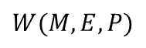
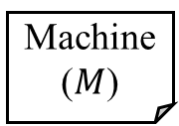
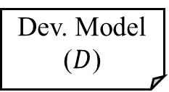
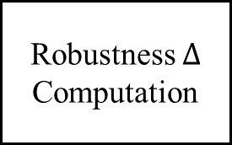
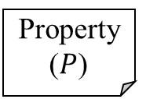
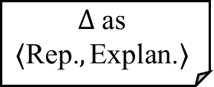
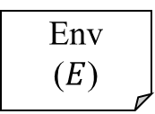
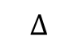
Robustness Analysis Summary
Introduction | Related Work | Thesis Statement | Robustness | Robustification-by-Control | Specification Weakening | Evaluation | Future Work | Conclusion
Dev. Model ($D$)
Machine ($M$)
Weakest Assumption Generation
Robustness $Δ$ Computation
Representation Traces and Explanations
Env
($E$)
$$Δ \text{as}$$
$$⟨\text{Rep}\text{.}, \text{Explan}\text{.}⟩$$
$$W(M,E,P)$$
$$Δ$$
Property ($P$)
A behavioral notion of robustness for software systems. Changjian Zhang, David Garlan, and Eunsuk Kang. (FSE 2020)
Notes:
To summarize, by taking the model of the machine, env, and a safety prop
We first compute the weakest assumption of the machine w.r.t. the prop, and the computes the model of robustness
Then, we propose a way to extract finite equivalence classes from the robustness model, and find a finite number of representations and explanations for more a user-friendly way of interpreting robustness.
This work is published at FSE 2020.

Slide 28
Robustification by Control
…, we can systematically measure and improve the behavioral robustness …
Improve robustness by generating a control w.r.t. a safety property.
Multi-objective optimization.
Notes:
So we have covered the part for robustness analysis and computation,
Now, I’ll discuss how we systematically improve the robustness.
The first method we present is called robustification-by-control.

Slide 29
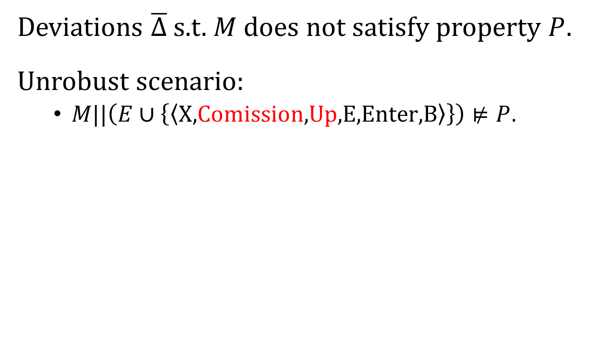
Intolerable Deviations
Introduction | Related Work | Thesis Statement | Robustness | Robustification-by-Control | Specification Weakening | Evaluation | Future Work | Conclusion
Select Mode
Deviations $\overline{Δ}$ s.t. $M$ does not satisfy property $P$.
Unrobust scenario:
$M||\left(E∪\left\{\left\langle \text{X}\text{,}\text{Comission}\text{,}\text{Up}\text{,}\text{E}\text{,}\text{Enter}\text{,}\text{B}\right\rangle \right\}\right)⊭P$.
Up
Go Back
X
E
Confirm Mode
Commission
Mode switching not completed yet!
Enter
Fire Beam
B
Task Complete
Transiting to
Notes:
Before we dive deep into the robustification method, let’s consider an intolerable deviation.
In contrast to robustness, we say deviations that would cause a violation are intolerable deviations.
For example, consider this unrobust scenario: …
The operator first chooses the X-ray mode, and the spreader is in place.
Then, they find they made a mistake and use Up to go back to the previous step and change to the Electron beam mode.
The spreader moves out, but the mode switching is still progress.
Then, if the operator fires the beam, the X-ray beam would be fired without the spreader.

Slide 30
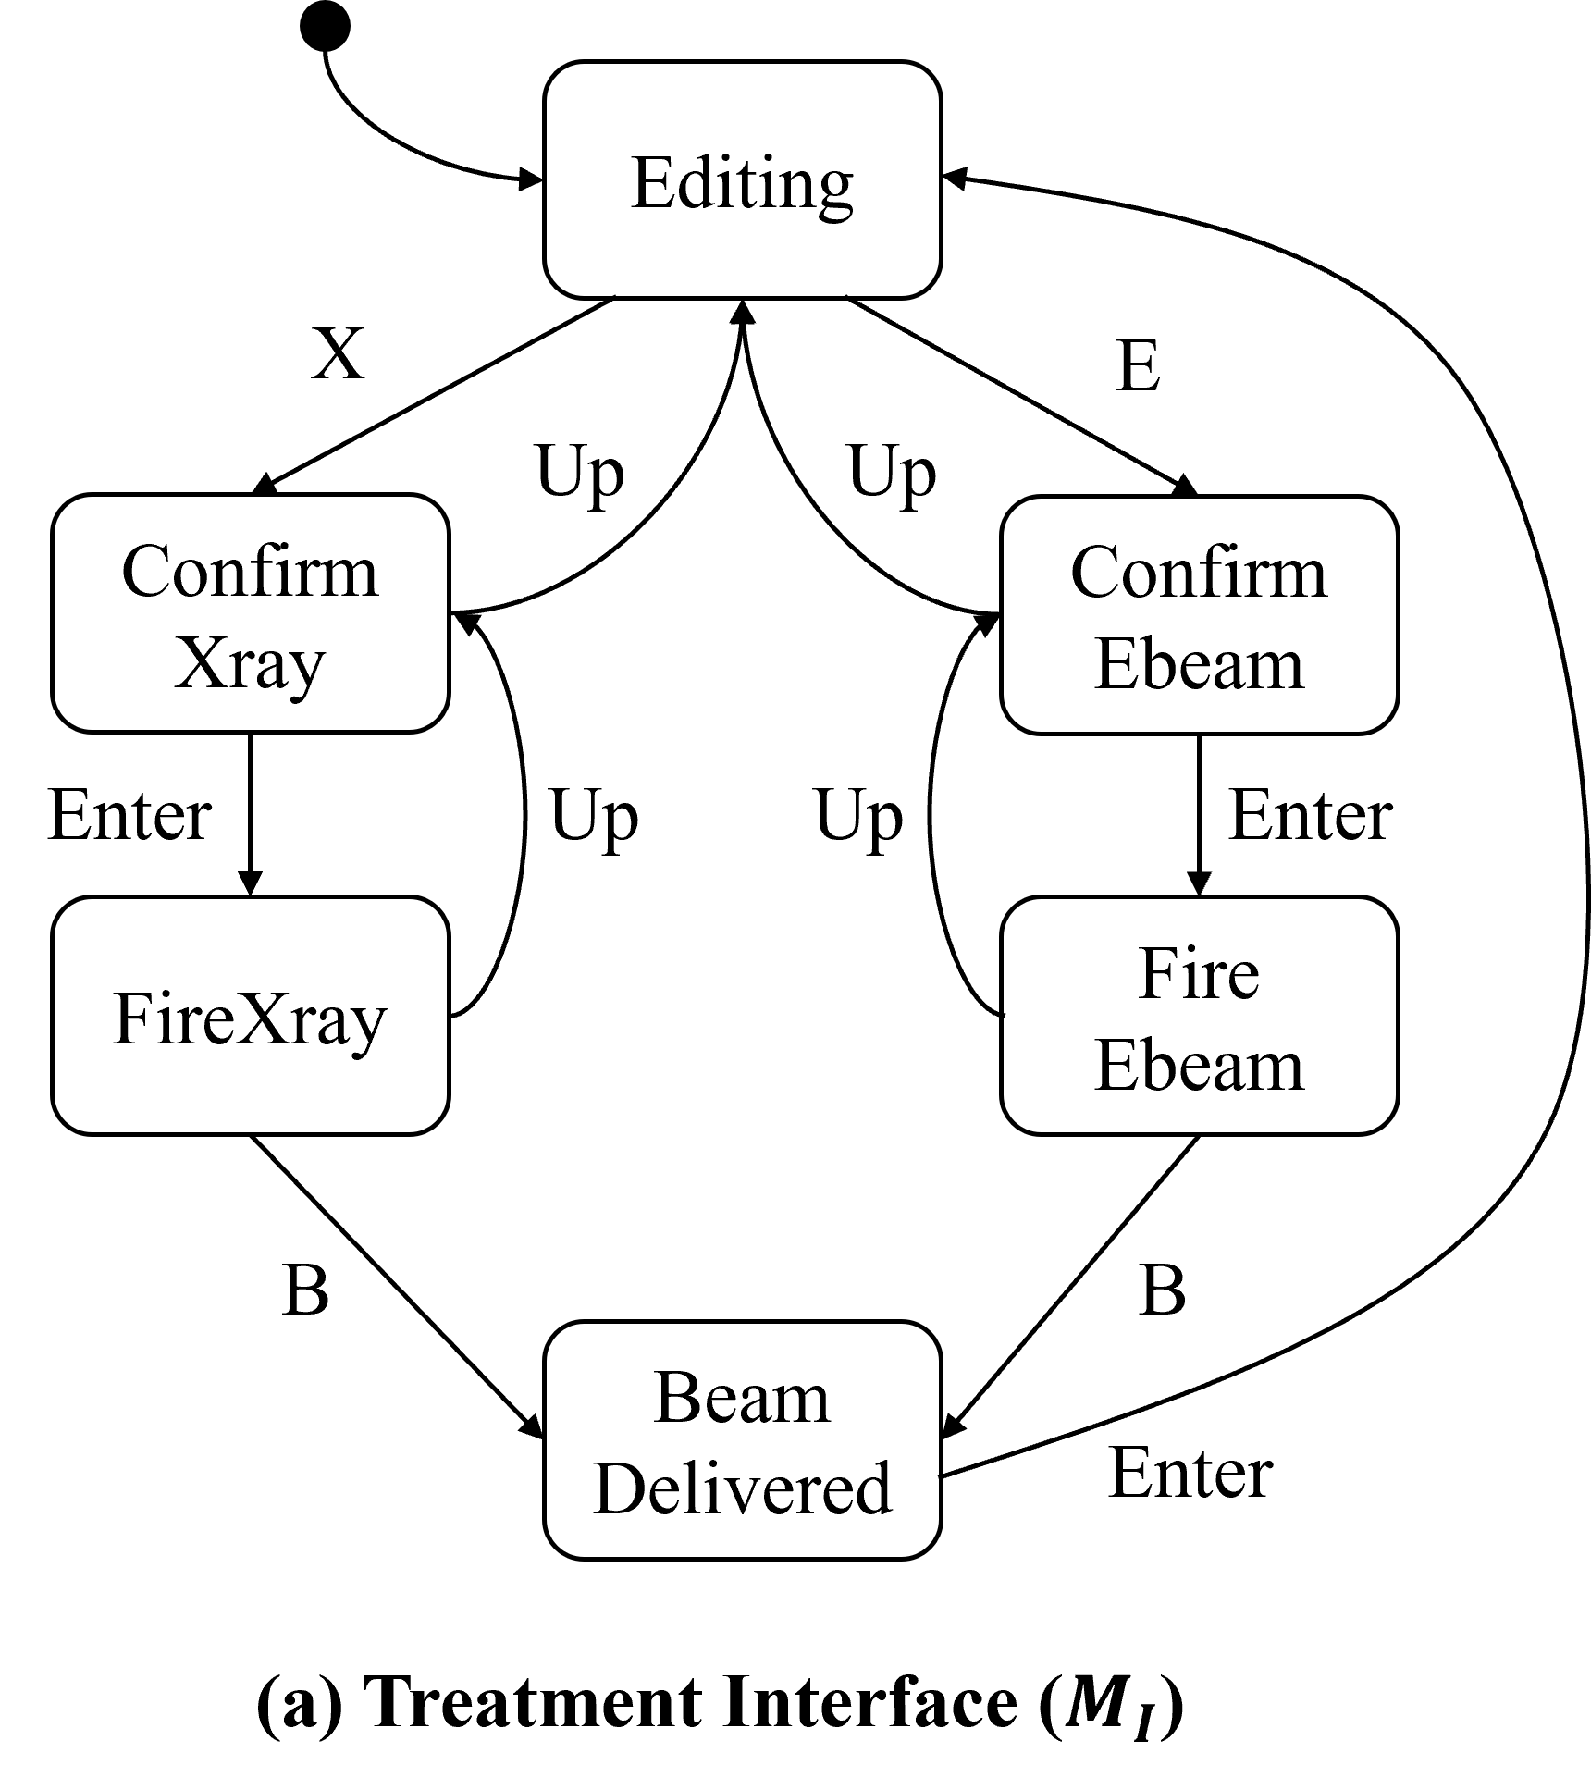
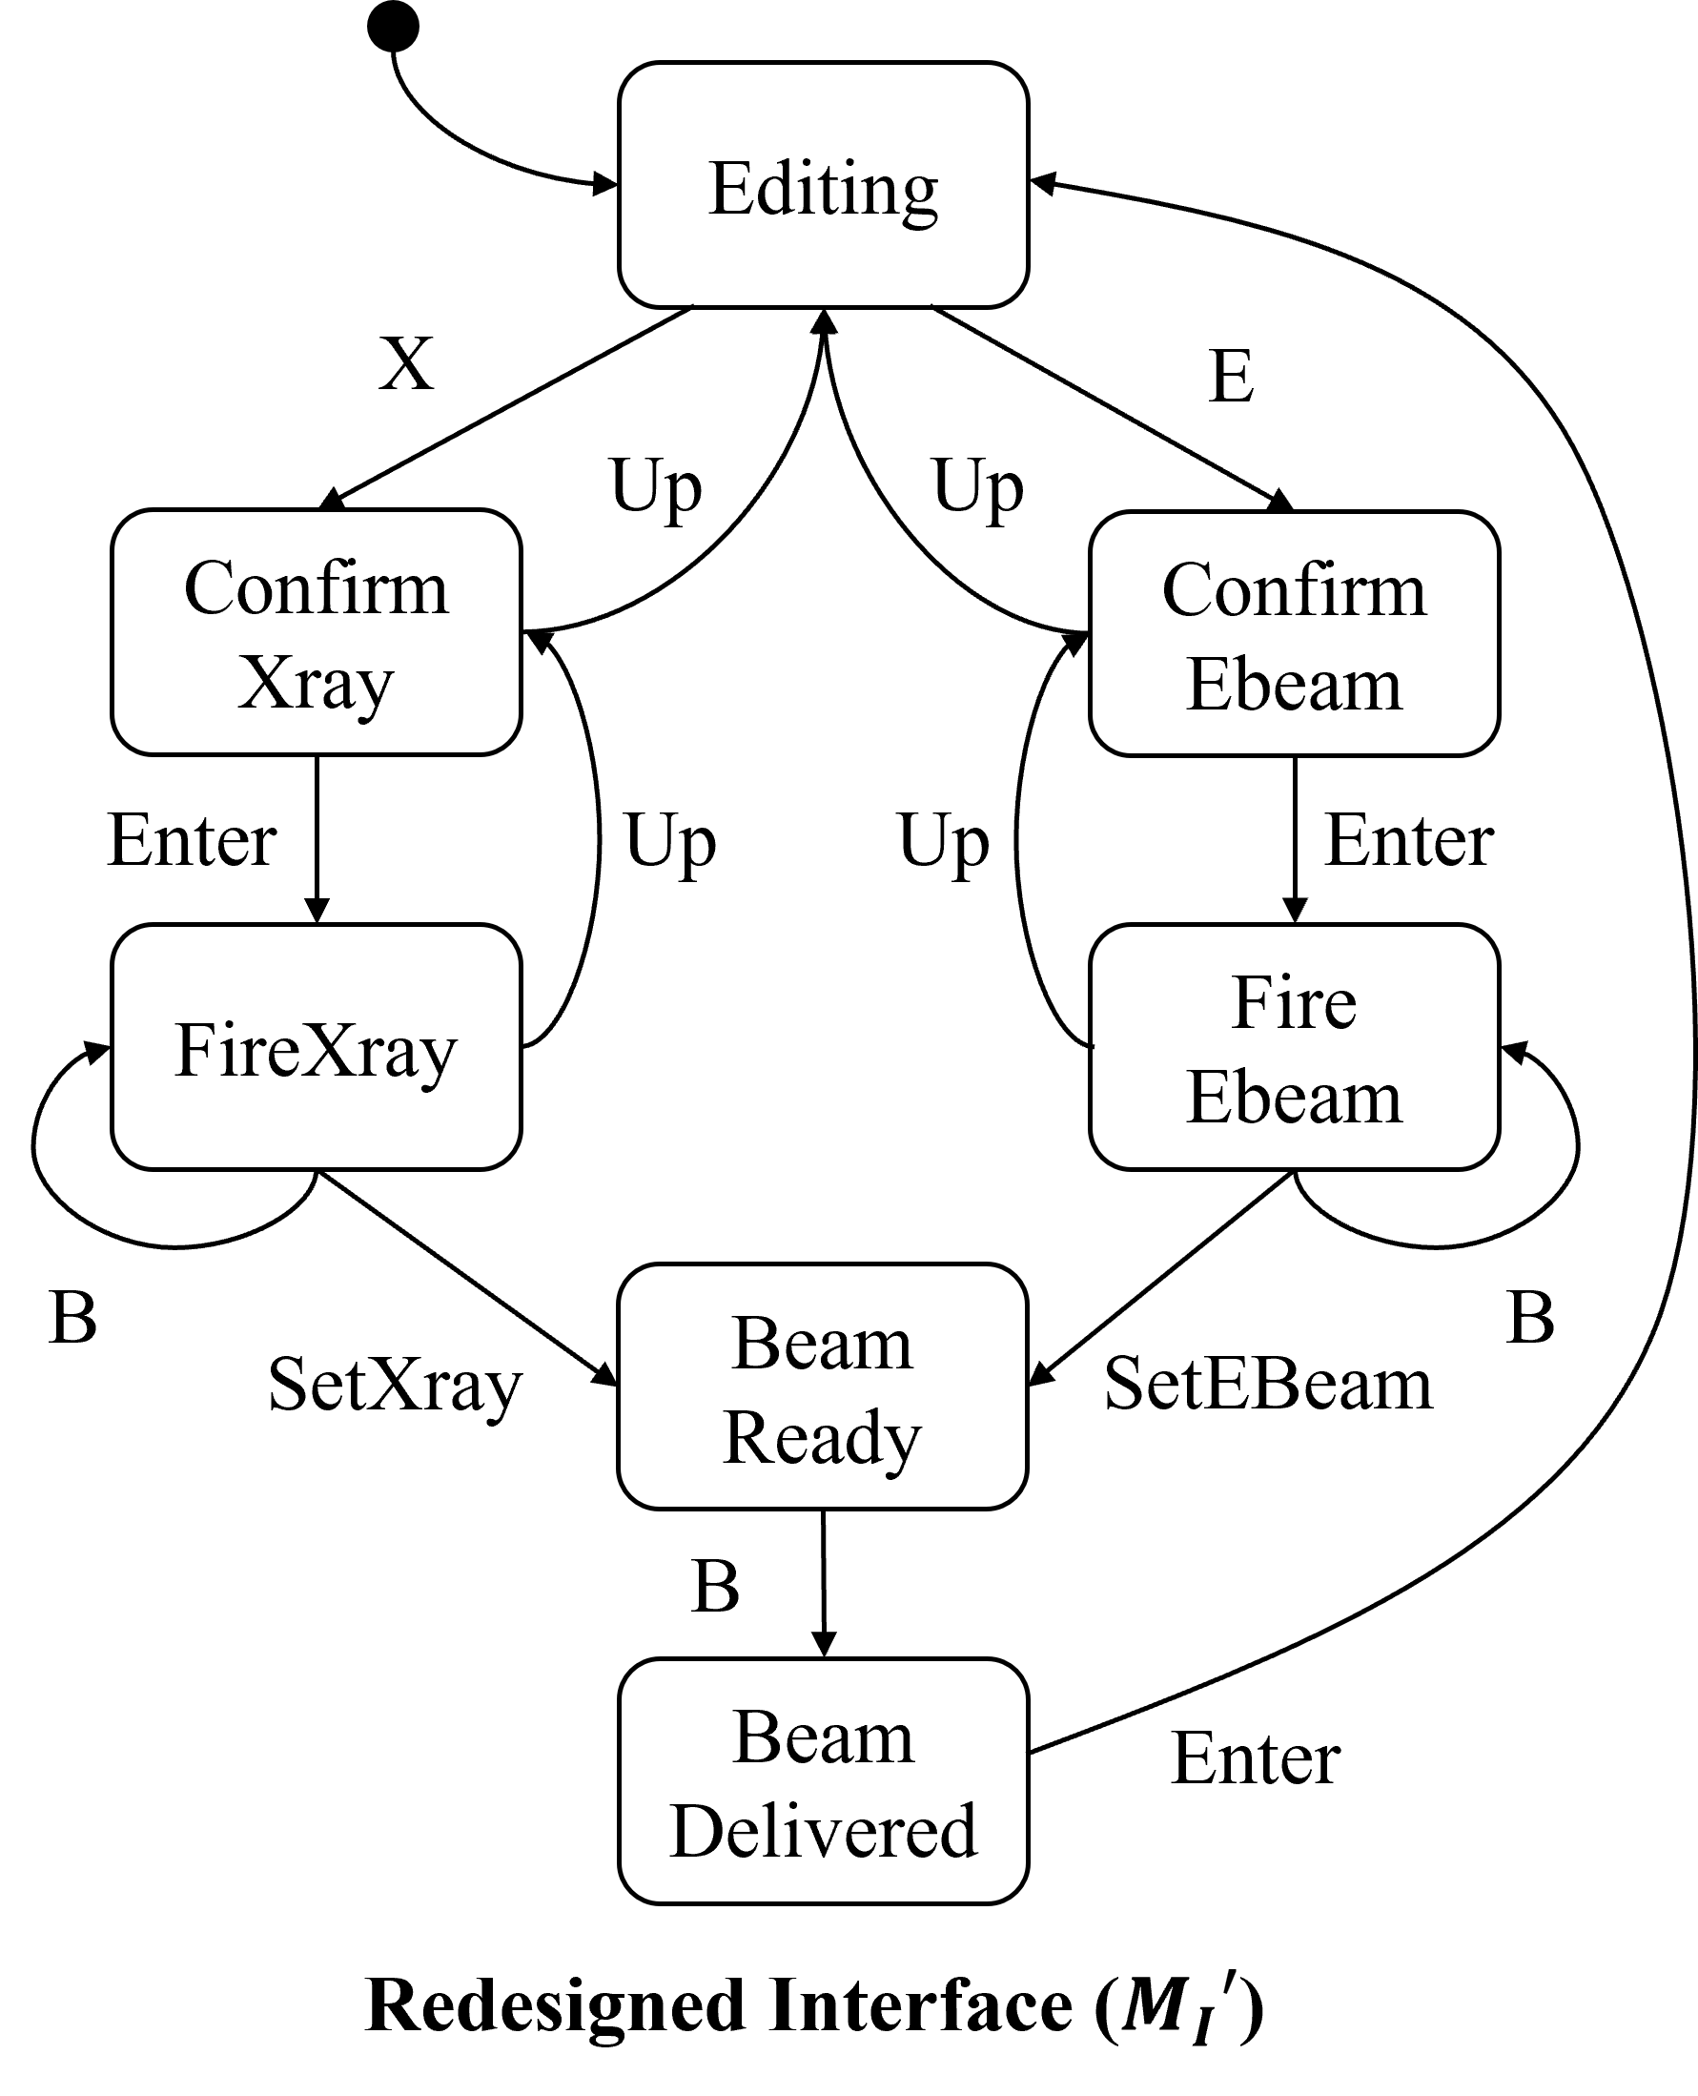
Trade-Offs between Solutions
Introduction | Related Work | Thesis Statement | Robustness | Robustification-by-Control | Specification Weakening | Evaluation | Future Work | Conclusion
Disable all up actions
Synchronize on mode-switching
Better functionalities, but Higher cost
Low cost, but Lose functionalities
Notes:
There are different ways to robustify the machine.
The first potential solution is to disable all up transitions. Which is a simple solution.
But if we also consider its trade-offs. For example, the cost to implement this modification and the system functionality.
One may argue that it has a low cost to implement with only disabling, but it will lose a critical functionality to allow the user to switch between beam modes.
Another solution is to let the interface to also synchronize on the mode switching. In this redesign, the interface will wait until the beam switching is completed, and then allow the user to fire the beam. One may argue that this solution has better functionality but it may have a larger cost to implement because we may need to implement additional synchronization mechanisms in the interface.
More importantly, these trade-offs are problem-dependent, they are unique in different problems.

Slide 31
Dimensions of Trade-Offs
Introduction | Related Work | Thesis Statement | Robustness | Robustification-by-Control | Specification Weakening | Evaluation | Future Work | Conclusion
Safety
Retain Functionalities
Observability
Controllability
Cost
Main goal is to ensure safety (e.g., by disabling actions).
But it may degrade functionalities (e.g., a machine that does nothing).
Increasing observability and controllability may allow finer-grained control.
But it may introduce additional implementation cost.
Notes:
In this work, we consider four dimensions of trade-offs.
Our main goal is to maintain safety, however we cannot completely disregard functionalities. Maintaining safety may cause functionality to degrade, e.g., …
One way to resolve the conflict is to increate the observability and controllability of the machine. Intuitively, when a machine can observe more events and control more events, it allows a finer-grained control so that it can retain functionality as well as avoid those bad states.
However, better controllability and observability come at a higher cost. For example, the machine may need additional physical sensors and physical control mechanisms.
Q: How much safety? Change how robust? Specification weakening.

Slide 32
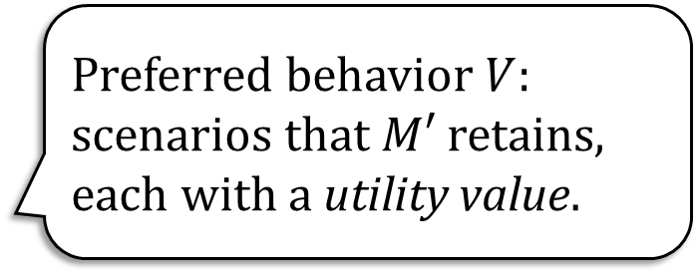
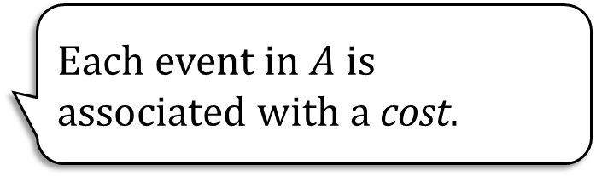
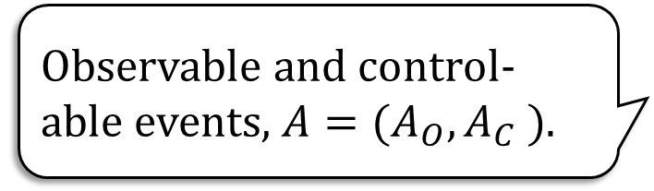
Robustification by Control
Introduction | Related Work | Thesis Statement | Robustness | Robustification-by-Control | Specification Weakening | Evaluation | Future Work | Conclusion
Ensure safety by disabling actions.
Safety
Retain Functionalities
Observability
Controllability
Cost
Preferred behavior $V$: scenarios that $M′$ retains, each with a utility value.
Observable and control-able events, $A=(A_{O}, A_{C} )$.
Each event in $A$ is associated with a cost.
Notes:
In our robustification-by-control method, we fix the safety prop and ensure safety by disabling actions in the machine based on the controllability of the machine.
We introduce the notion of pref beh to measure the retained functionalities of the system. Each describe an execution scenario and is associated with a utility value.
Then, the controllability and observability of the system is modeled as the set of observable and controllable events in the machine.
Finally, we measure the implementation cost by associating a cost to each controllable and observable event.
So our robustification method needs to balance between these dimensions.
To retain more functionalities, we may need more controllable and observable events, which result in a higher cost.
We can also choose to sacrifice on certain functionalities, so it may need fewer events, and result in a lower cost.
Q: Exact definition of pref beh? A full execution? Or States？

Slide 33
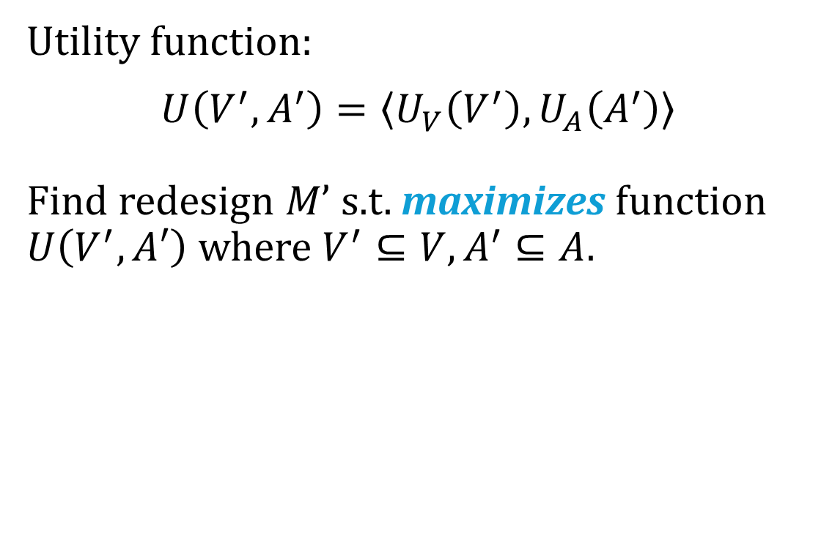
Multi-Objective Optimization
Introduction | Related Work | Thesis Statement | Robustness | Robustification-by-Control | Specification Weakening | Evaluation | Future Work | Conclusion
Safety
Retain Functionalities
Observability
Controllability
Cost
Utility function:
$$U\left(V^{′},A^{′}\right)=\left\langle U_{V}\left(V^{′}\right),U_{A}\left(A^{′}\right)\right\rangle$$
Find redesign $M’$ s.t. maximizes function $U\left(V^{′},A′\right)$ where $V^{′}⊆V,A^{′}⊆A$.
Pareto-Front
Cost
Pareto-Optimal
Preferred Beh.
Notes:
So we can formulate the problem as a multi-objective optimization problem.
The user can provide a utility function U, it returns the earned utility values from the retained functionalities, and the cost of the controllable and observable events.
We want to find redesigns that maximizes this utility function, where V’ is a subset of pref behs, and A’ is a subset of available events that need to be controllable or observable.
Since it is a multi-objective problem, we consider pareto optimality.
In short, a solution is pareto-optimal, for example, given its retained functionality, we should not find another solution with a lower cost.
But there could be another solution retain more functionality but with more cost.
Q: Is the utility user defined? Can you search multiple pareto-optimal?

Slide 34
Supervisory Control Theory
Introduction | Related Work | Thesis Statement | Robustness | Robustification-by-Control | Specification Weakening | Evaluation | Future Work | Conclusion
Controller
Observe events in the machine and env.
Ensure the safety property by disabling events.
System
Machine
Deviated
Env.
satisfy
Property
Notes:
To achieve this, we leverage supervisory control.
The high level idea is that the system, i.e., the machine with the deviated env, does not satisfy the desired prop.
Supervisory control defines the problem to find a controller so that the system can then satisfy the prop.
The controller can observe events in the machine and the environment.
And it ensures the safety prop by disabling events in the system, based on the set of observable and controllable events provided by the user.

Slide 35
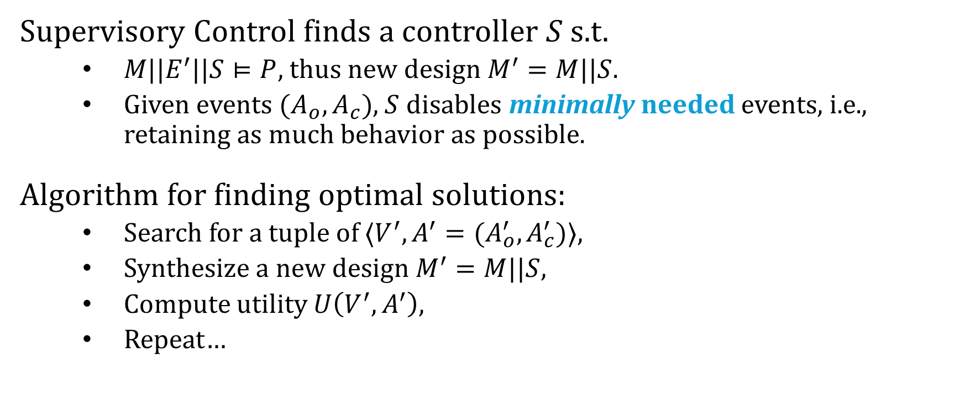
Optimal Robustification by Control
Introduction | Related Work | Thesis Statement | Robustness | Robustification-by-Control | Specification Weakening | Evaluation | Future Work | Conclusion
Supervisory Control finds a controller $S$ s.t.
$M||E^{′}||S⊨P$, thus new design $M^{′}=M||S$.
Given events $(A_{o},A_{c})$, $S$ disables minimally needed events, i.e., retaining as much behavior as possible.
Algorithm for finding optimal solutions:
Search for a tuple of $⟨V^{′},A^{′}=(A_{o}^{′},A_{c}^{′})⟩$,
Synthesize a new design $M^{′}=M||S$,
Compute utility $U\left(V^{′},A^{′}\right)$,
Repeat…
Cost
Preferred Beh.
Notes:
The idea of supervisory control can also be represented as, for machine M and the deviated env E’, by composing them with a controller S, it can then satisfy the prop. So the new design can be represented as M composed with S.
There’s also a nice prop about supervisory control. Given a set of controllable and observable events, it disables minimally needed events, in other words, it will retain as much behavior as possible, which aligns with one of our goal.
So we develop an algorithm for searching pareto-optimal solutions that uses supervisory control synthesis as a primitive.
In general, the algorithm generates a candidate tuple of preferred behaviors and events, and invoke a synthesis process to find a controller, if there is a controller, then we get a candidate solution and compute its utility value.
We repeat this process by removing pref behaviors and events, so that we can find one or enumerate all pareto optimal solutions.

Slide 36








Robustification by Control Summary
Introduction | Related Work | Thesis Statement | Robustness | Robustification-by-Control | Specification Weakening | Evaluation | Future Work | Conclusion
Machine ($M$)
Env
($E$)
Property ($P$)
$$V^{′}⊆V$$
$${(A}_{c}^{′},A_{o}^{′})⊆(A_{c},A_{o})$$
Design Optimizer
Supervisory Control Synthesis
Candidate Solution $M’$
Intolerable Dev. ($\overline{δ}$)
Pref. Behaviors ($V$)
Ctrl./Obs. Events ($A_{c},A_{o}$)
Optimal new designs $M’$
Robustification of Behavioral Designs against Environmental Deviations. Changjian Zhang, Tarang Saluja, Romulo Meira Goes, Matthew Bolton, David Garlan, and Eunsuk Kang. (ICSE 2023).
Notes:
In sum, the robustification-by-control process takes a deviated environment, and uses supervisory control synthesis to find a robustified design.
We introduce pref beh and costs over controllable and observable events to balance the trade-offs among the new designs.
We formulate the problem as a multi-objective optimization problem, and propose an algorithm to find pareto-optimal solutions.
This work is published at ICSE 2023.

Slide 37
Robustification by Specification Weakening
…, we can systematically measure and improve the behavioral robustness …
Weaken the safety property to maintain more system functionality.
LTL learning.
Notes:
We have covered the robustification-by-control method,
Next, I will talk about another robustification tactic, called specification weakening.

Slide 38
Trade-Offs in the Safety Dimension
Introduction | Related Work | Thesis Statement | Robustness | Robustification-by-Control | Specification Weakening | Evaluation | Future Work | Conclusion
Lower cost
Weakening the safety property can:
Reduce implementation cost
Safety
Retain Functionalities
Observability
Controllability
Cost
Notes:
Recall that in robustification-by-control, we fix the safety property, but this may not always produce satisfactory solutions.
So in this method, we consider weakening the safety requirement.
In some scenario, weakening the safety prop can retain the same functionality with a lower cost.

Slide 39
Trade-Offs in the Safety Dimension
Introduction | Related Work | Thesis Statement | Robustness | Robustification-by-Control | Specification Weakening | Evaluation | Future Work | Conclusion
More functionality
Weakening the safety property can:
Reduce implementation cost
Retain more functionality
But should still ensure the most critical safety requirement.
Safety
Retain Functionalities
Observability
Controllability
Cost
Notes:
Or, it may retain the more functionality but with the same cost.
However, of course, we should still ensure that the most critical safety requirement is guaranteed.
Or in other words, the new property should not be too weak to allow any behavior.
In particular, in this work, we focus on weakening the safety prop to retain more functionality.
But when would this situation happen?

Slide 40


Conflicts between Safety and Functionality
Introduction | Related Work | Thesis Statement | Robustness | Robustification-by-Control | Specification Weakening | Evaluation | Future Work | Conclusion
Disable all up actions
Safety: no over-dose,
$$\text{G}\left(Xray⇒InPlace\right)$$
Functionality (Pref. behavior): beam switch,
$$⟨\text{X}\text{,}\text{Up}\text{,}\text{E}\text{,}\text{Enter}\text{,}\text{B}⟩$$
Robustification-by-control: must disable $Up$ transitions.
$X$, (Xray mode and spreader in place)
$Up$, (Xray mode and in place)
$E$, (Xray mode and out of place, switching in progress)
Although beam not fired, no over-dose occurs yet.
Notes:
Let’s revisit the therapy machine example. We say we want to ensure no over-dose caused by X-ray.
However, I haven’t formally defined the property. Then, let’s consider specifying this requirement in LTL.
One may write, globally, if it is in Xray mode, the spreader should be in place, which avoids over-dose.
Meanwhile, we have the pref beh X Up E Enter B to allow mode switching from Xray to Electron beam.
But when we run robustification-by-control, a solution must disable the Up transition, which disables mode switching, to ensure the safety property.
But why? If we walk through the execution, we first press X …, then Up …, then E, …
And it already violate the property, even though the beam has not yet fired.

Slide 41

Conflict Resolution by Weakening
Introduction | Related Work | Thesis Statement | Robustness | Robustification-by-Control | Specification Weakening | Evaluation | Future Work | Conclusion
Synchronize on mode-switching
Conflict between a restrictive safety prop.,
$$\text{G}\left(Xray⇒InPlace\right)$$
and a functionality in pref. behavior,
$$⟨\text{X}\text{,}\text{Up}\text{,}\text{E}\text{,}\text{Enter}\text{,}\text{B}⟩$$
Resolve by weakening the safety prop., no over-dose while firing,
$$\text{G}\left(Xray∧Fired⇒InPlace\right)$$
Then, re-run robustification-by-control.
Notes:
In this situation, the safety prop is too restrictive. It may be caused by modeling mistakes, unforeseen challenges, or requirement evolution.
From requirement engineering, we can choose to weaken the safety prop to resolve the conflict.
For example, in our example, we can weaken the prop to no over-dose while firing the beam.
In LTL, we add a conjunction to Xray, so it becomes, when the machine is in Xray mode and the beam is fired, the spreader must be in place.
It is weaker because it allows a temporary mismatch between the beam and the spreader, but can still ensure the most critical safety requirement.
Then, re-running robustification-by-control, we are able to get a solution that retains the mode switching function.
In fact, in previous sections, I implicitly assumed that the over-dose property is defined in this way.

Slide 42



Weakening by LTL Learning
Introduction | Related Work | Thesis Statement | Robustness | Robustification-by-Control | Specification Weakening | Evaluation | Future Work | Conclusion
$𝒫$, set of positive examples
$𝒩$, set of negative examples
LTL Learner
Formula $f$ s.t.
$f$ holds on all positives
$f$ does not hold on all negatives
Notes:
To achieve weakening, we leverage LTL learning.
The basic idea of LTL learning is that by given a set of positive examples and a set of negative examples
The LTL learner can generate a formula such that it holds on all positive examples and does not hold on all negative ones.

Slide 43

Example Generation and Identification
Introduction | Related Work | Thesis Statement | Robustness | Robustification-by-Control | Specification Weakening | Evaluation | Future Work | Conclusion
LTL Learner
Positives &
Negatives
Pref. behavior:
$$⟨\text{X}\text{,}\text{Up}\text{,}\text{E}\text{,}\text{Enter}\text{,}\text{B}⟩$$
Example Generation
Executions
Example Identification
Notes:
Since there’s a conflict between the safety and the pref beh. So we have an unsatisfied pref beh.
Then we propose a semi-automated process, first we can generate a set of examples from the unsatisfied pref beh.
Then, the users such as stakeholders or developers are responsible for identifying positive and negative ones and provide them to the learner.
We can discuss the details in the QA session.
Q: Is it possible to automate the weakening?

Slide 44



Weakening Pattern Constraints
Introduction | Related Work | Thesis Statement | Robustness | Robustification-by-Control | Specification Weakening | Evaluation | Future Work | Conclusion
Assume safety properties in $\text{G}(φ∧φ^{′}∧…⇒ψ∨ψ′∨…)$
Constraints
A constrained LTL learner with Alloy/AlloyMax! (FSE 2021, ICSE 2025)
CNF
DNF
Constraints
Original safety:
$$\text{G}\left(Xray⇒InPlace\right)$$
LTL Learner
Positives &
Negatives
Pref. behavior:
$$⟨\text{X}\text{,}\text{Up}\text{,}\text{E}\text{,}\text{Enter}\text{,}\text{B}⟩$$
Example Generation
Executions
Example Identification
Weakened safety:
$$\text{G}\left(Xray∧Fired⇒InPlace\right)$$
Notes:
In addition, because we are doing weakening, we need the old property.
In particular, we consider a particular type of safety properties and a weakening pattern.
We have G \phi implies \psi and we can append conjunctions to phi or disjunctions to psi to gradually weaken the property.
So by introducing minimal number of conjunctions or disjunctions, the property is minimally weakened.
However, of course, this is a syntactic based minimal weakening.
So We add the original prop and this weakening pattern as constraints to the learner.
And finally, it can find a solution as I just showed.
In fact, existing off-the-shelf learners do not support an expressive enough way to define these constraints. So we build our own learner by leveraging, also our work, on AlloyMax. We can further discuss this in the QA session.

Slide 45

Specification Weakening Summary
Introduction | Related Work | Thesis Statement | Robustness | Robustification-by-Control | Specification Weakening | Evaluation | Future Work | Conclusion
Notes:
So, in sum, our weakening method focus on the situation where the safety requirement conflicts with the functionality.
Given an unsatisfied pref beh, we generate a set of concrete system executions.
This method is semi-automated, where the users, such as developers, stakeholders, are responsible for identifying the safe and unsafe scenarios.
Then, we provide these examples to our LTL learner, together with additional constraints on the weakening pattern
To find a weakened property.

Slide 46
Fortis and Evaluations
…, we can systematically measure and improve the behavioral robustness …
A tool implementing the proposed approaches.
Evaluations based on 5 case studies.
Notes:
So, I’ve introduced the three major contributions of our work, namely, robustness computation, robustification-by-control, and specification weakening.
Next, I will discuss our implementation and evaluation

Slide 47




Fortis: A Tool for Robust-by-Design
Introduction | Related Work | Thesis Statement | Robustness | Robustification-by-Control | Specification Weakening | Evaluation | Future Work | Conclusion
FMCAD 2023
Notes:
We implement all our techniques in our tool named Fortis, it also has a simple web-based user interface.

Slide 48
Evaluation: Applicability and Performance
Introduction | Related Work | Thesis Statement | Robustness | Robustification-by-Control | Specification Weakening | Evaluation | Future Work | Conclusion
RQ: Are our techniques applicable across multiple domains of problems?
Demonstrate through case studies.
Be able to:
Computed robustness.
Find re-designs by robustification-by-control.
Weaken their safety properties and find re-designs.
RQ: How efficient do our approaches perform? How well do they scale?
Derive benchmarks from the case studies.
Notes:
For all of techniques, our evaluation focuses on their applicability and performance.
For applicability, we evaluate whether our techniques can apply to problems from different domains.
For our case studies, we compute their robustness, find re-designs for improving their robustness, and weaken their safety properties to find new re-designs.
For the performance evaluation, we scale up these case study problems to derive benchmark problems.

Slide 49

Evaluation Case Studies
Introduction | Related Work | Thesis Statement | Robustness | Robustification-by-Control | Specification Weakening | Evaluation | Future Work | Conclusion
Therac-25 radiation machine
ABP protocol
iVotronic voting machine
Oyster public transportation system
Infusion pump
Notes:
Other the therac25 example, we considered:

Slide 50
Robustness Computation Results
Introduction | Related Work | Thesis Statement | Robustness | Robustification-by-Control | Specification Weakening | Evaluation | Future Work | Conclusion
Problem | Model Size | Time (s)
Therac-25 | 35 | 0.098
Naïve Protocol | 41 | 0.102
ABP | 23 | 0.177
Voting-1-1 | 69 | 0.150
Voting-2-2 | 373 | 0.178
Voting-3-3 | 1,109 | 0.230
Voting-4-4 | 2,469 | 0.296
Oyster-1 | 289 | 0.203
Oyster-3 | 961 | 0.310
Oyster-5 | 2,017 | 0.522
Pump-1 | 163 | 0.141
Pump-2 | 1,679 | 0.263
Pump-3 | 19,435 | 1.097
Notes:
Here are the robustness computation results.
On the right, we have the problems and the scaled up ones.
Q: How are problems scaled?

Slide 51
Robustification-by-Control Results
Introduction | Related Work | Thesis Statement | Robustness | Robustification-by-Control | Specification Weakening | Evaluation | Future Work | Conclusion
Problem | Vanilla |  | OASIS |  | Our Approach
 | Solution | Time (s) | Solution | Time (s) | Solution | Time (s)
Therac-25 | ✓ | 0.253 | ✓ | 0.245 | ✓ | 0.369
Voting-1-1 | × | 0.231 | ⊘ | 0.322 | ✓ | 0.416
Voting-2-2 | × | 0.378 | × | 7.864 | ✓ | 1.609
Voting-3-3 | × | 0.973 | × | 152.846 | ✓ | 8.820
Voting-4-4 | × | 2.864 | × | T/O | ✓ | 95.488
Oyster-1 | ✓ | 0.310 | ✓ | 0.305 | ✓ | 0.320
Oyster-3 | ✓ | 0.417 | ✓ | 0.472 | ✓ | 0.492
Oyster-5 | ✓ | 0.592 | ✓ | 0.668 | ✓ | 0.691
Pump-1 | × | 0.269 | ⊘ | 0.765 | ✓ | 0.937
Pump-2 | × | 0.689 | ⊘ | 5.083 | ✓ | 8.706
Pump-3 | × | 4.329 | ⊘ | 222.528 | ✓ | 346.211
Only controller synthesis
Controller synthesis with event abstraction (allowing adding new behaviors).
Notes:
Then, we show the robustification by control results. We compare our method with two baseline methods called Vanilla controller synthesis and OASIS.
Vanilla approach only tries to ensure safety by disabling
OASIS propose an abstraction-based approach to find more feasible solutions. I’ll leave the details of them in the QA session.

Slide 52
Robustification-by-Control Results
Introduction | Related Work | Thesis Statement | Robustness | Robustification-by-Control | Specification Weakening | Evaluation | Future Work | Conclusion
Problem | Vanilla |  | OASIS |  | Our Approach
 | Solution | Time (s) | Solution | Time (s) | Solution | Time (s)
Therac-25 | ✓ | 0.253 | ✓ | 0.245 | ✓ | 0.369
Voting-1-1 | × | 0.231 | ⊘ | 0.322 | ✓ | 0.416
Voting-2-2 | × | 0.378 | × | 7.864 | ✓ | 1.609
Voting-3-3 | × | 0.973 | × | 152.846 | ✓ | 8.820
Voting-4-4 | × | 2.864 | × | T/O | ✓ | 95.488
Oyster-1 | ✓ | 0.310 | ✓ | 0.305 | ✓ | 0.320
Oyster-3 | ✓ | 0.417 | ✓ | 0.472 | ✓ | 0.492
Oyster-5 | ✓ | 0.592 | ✓ | 0.668 | ✓ | 0.691
Pump-1 | × | 0.269 | ⊘ | 0.765 | ✓ | 0.937
Pump-2 | × | 0.689 | ⊘ | 5.083 | ✓ | 8.706
Pump-3 | × | 4.329 | ⊘ | 222.528 | ✓ | 346.211
Notes:
Let’s first focus on the solution column. Here, we show that, our method can always find a solution that satisfies the safety prop and retain a pre-defined set of pref behs.
X means it cannot find a solution, empty set symbol means it can find a solution but not satisfying all pref beh.

Slide 53
Robustification-by-Control Results
Introduction | Related Work | Thesis Statement | Robustness | Robustification-by-Control | Specification Weakening | Evaluation | Future Work | Conclusion
Problem | Vanilla |  | OASIS |  | Our Approach
 | Solution | Time (s) | Solution | Time (s) | Solution | Time (s)
Therac-25 | ✓ | 0.253 | ✓ | 0.245 | ✓ | 0.369
Voting-1-1 | × | 0.231 | ⊘ | 0.322 | ✓ | 0.416
Voting-2-2 | × | 0.378 | × | 7.864 | ✓ | 1.609
Voting-3-3 | × | 0.973 | × | 152.846 | ✓ | 8.820
Voting-4-4 | × | 2.864 | × | T/O | ✓ | 95.488
Oyster-1 | ✓ | 0.310 | ✓ | 0.305 | ✓ | 0.320
Oyster-3 | ✓ | 0.417 | ✓ | 0.472 | ✓ | 0.492
Oyster-5 | ✓ | 0.592 | ✓ | 0.668 | ✓ | 0.691
Pump-1 | × | 0.269 | ⊘ | 0.765 | ✓ | 0.937
Pump-2 | × | 0.689 | ⊘ | 5.083 | ✓ | 8.706
Pump-3 | × | 4.329 | ⊘ | 222.528 | ✓ | 346.211
Notes:
Then, we show the robustification by control results. We compare our method with two baseline methods called Vanilla controller synthesis and OASIS. I’ll leave the details of them in the QA session.
Let’s first focus on the solution column. Here, we show that, our method can always find a solution that satisfies the safety prop and retain a pre-defined set of pref behs.
Q: Why is there a time but no solution? The Vanilla and OASIS do not consider pref beh. So we run them to find a solution and then decide whether pref behs are satisfied. So (1) the algorithm terminates but no solution (2) find a solution but does not satisfy pref beh.

Slide 54
Specification Weakening Results
Introduction | Related Work | Thesis Statement | Robustness | Robustification-by-Control | Specification Weakening | Evaluation | Future Work | Conclusion
Requirements
Conflicts?
Run robustification-by-control
Example generation
LTL learning
Re-run robustification-by-control
Robustification
by Control
Yes
Specification
Weakening
Resolved
Requirements
Problem | 1st-Robustification | Example Gen. | LTL Learn. | 2nd-Robustification
Therac-25 | 0.059 | 0.023 | 0.131 | 0.084
Voting | 0.116 | 0.038 | 0.221 | 0.176
Oyster | 0.154 | 0.129 | 0.385 | 0.277
Pump | 0.408 | 0.179 | 0.993 | 0.691
Notes:
Finally, for the weakening method, because it is used alongside robustification-by-control
The full process would be like, we run the first robustification-by-control, there is unsatisfied pref beh, so we weaken the prop, and rerun robustification-by-control.
So, we first show that the weakening process does not introduce significant performance overhead compared to robustification-by-control.
From this table, we can see that although the total time for example generating and LTL learning take longer than robustification-by-control. The solving time is still in seconds and thus acceptable.

Slide 55
Future Work
Notes:
Finally, I’d like to briefly talk about potential future work.

Slide 56
From Liveness to many more…
Introduction | Related Work | Thesis Statement | Robustness | Robustification-by-Control | Specification Weakening | Evaluation | Future Work | Conclusion
Robustness w.r.t. liveness properties.
Liveness spec: LTL?
Weakest assumption for liveness: the minimum set of behaviors?
General LTL: a mix of safety and liveness.
Robustification w.r.t. LTL.
Reactive synthesis: how to encode retaining behavior and cost?
Need of adding new behaviors (e.g., retry, use of OASIS).
Specification weakening w.r.t. LTL.
Weakening for liveness: robust LTL (rLTL)?
Notes:
There are still quite many directions we can improve on this work, some of them are more about theory foundations, some of them are more about a better engineering.
I’d like to start with Liveness because it is tangled with many other dimensions.
First, our work focus on safety with a very lightweight notion of liveness when we do robustification, which is pref beh.
So, one intuitive direction is what about liveness properties.
The first challenge is how we specify liveness. Right now, we assume safety defined in LTS or a subset of safety prop in LTL. They both represent an upper bound of the expected behavior.
For liveness, traditionally it cannot be presented in LTS, so we have to support LTL. But usually, LTL relies on Kripke structure, which is a state-based model, so we have to build the connection between LTS and Kripke structure, where we may leverage FLTL.
How can we compute robustness wrt liveness. One idea is to continue using weakest assumption, but now for liveness, is the minimum set of behaviors, in other words a lower bound of behavior.
Finally, if we support general LTL, is it possible to compute robustness w.r.t. a mix of safety and liveness. What would it look like?
For robustification, if we can support LTL, perhaps we can leverage reactive synthesis techniques to find a new design. However, typically, reactive synthesis considers only a set of LTL requirements. So we still have to address the challenges on encoding our two quality goals into the synthesis process.
On the other hand, if our property contains liveness, removing behavior as we did in robustification may not be enough, because from a high-level, liveness talks about a system should reach certain good states. So we have the need of adding new behaviors, behaviors that do not exist in the original machine and environment. E.g., retry in a network protocol. One idea is to incorporate the method of OASIS, however it has its own issue and limitation.
Finally, currently, we only consider the weakening of a very specific pattern of safety properties. We could also consider weakening any LTL in the future. Particularly, the robust LTL may be a promising direction, where they consider a total order of how an LTL formula is satisfied. E.g., for property Gp, a weaker version of it is FGp. However, note that, we cannot support this right now, because Gp to FGp converts a pure safety property to a liveness property.
There are also other aspects that we can extend this work, but I’ll stop here.

Slide 57
Conclusion
Notes:
Here comes the conclusion

Slide 58

Contributions Summary
Introduction | Related Work | Thesis Statement | Robustness | Robustification-by-Control | Specification Weakening | Evaluation | Future Work | Conclusion
A behavioral notion of robustness based on LTS and its computation method.
Contrib. 4: tool Fortis
Weaken the safety property to maintain more system functionality.
Improve robustness by generating a controller w.r.t. the safety property.
Notes:
In sum, this thesis focus on the challenges on systemically measuring and improving software robustness in the sense of system behavior and have a focus on safety of software.
We proposal a formal notion of behavioral robustness and present a way to compute it.
We then present two methods for improving robustness.
Finally, these techniques are implemented in our tool Fortis.
Case study: Why case studies are chosen? What are things we will do in the future? Trace back to why we need these case studies. What experiments and evaluation we have done. Relate back to the thesis statement.

Slide 59








Acknowledgements
Introduction | Related Work | Thesis Statement | Robustness | Robustification-by-Control | Specification Weakening | Evaluation | Future Work | Conclusion
Thesis Committee
SoDA Lab
ABLE Group
Thanks to other faculties, colleagues, staff in S3D and MSE.
Thanks to my family for their endless support
Notes:
First of all, I’d like to thank my wonderful advisors Eunsuk and David. In some sense, without the models class offered by David and Eunsuk, I won’t even have learned about formal methods and decided to purse this PhD.
Then, I’d like to thank my wonderful committee members, thank you for providing those valuable feedbacks and supporting this work.
And I’d also like to thank my colleagues from both the research group SoDA and ABLE. Thanks for all those discussions in meetings and other various situations.
I’d also like to thank other faculties and colleagues and staff in the department and also the MSE program for offering all kinds of help.
Finally, thanks to my family for their endless support!

Slide 60

Existing Robustness Definitions
Qualitatively, if the inputs are invalid, e.g., out-of-range values,
Wrong output values? Crashes? (Koopman et al.)
Software Machine
Inputs
Outputs
Quantitatively and formally, small distance from input $i^{′}$ to expected input $i_{e}$,
Small distance value in the output value. (Tabuada et al.)
Notes:
Phillip Koopman, Paulo Tabuada

Slide 61
Gaps in Robustness Improvement
Implementation improvement:
Wrapper of code.
Defensive programming, Clean Code, Effective Java, …
Self-adaptive system and Runtime assurance:
Improve “robustness” implicitly.
A broader set of properties: performance, availability, …
More than robustness, e.g., recoverability, …
Architecture tactics:
SEI robustness report.
Simplex architecture.
Design
Robustness
Analysis
Developer, Designer,
Architect
Robustify
Design
Notes:
Traditional robustness improvement techniques also focus more on implementation.
Build wrapper over existing code to filter out invalid inputs and outputs; advocate the use of best programming practices like…
On the other hand, work from self-adaptive and runtime assurance are more closely related to our notion of robustness.
They also consider the behavior of the system, and many of their methods can improve robustness even though the term robustness may not be explicitly used.
Also, we focus on safety and liveness, but they are also interested in a broader set of props, like …
In addition, other than robustness, they also consider recoverability, i.e., to allow the system degrade under deviations but then recover from them.
Lastly, there work of robustness from an architecture perspective, like SEI… However, they are very high-level guidance on design
Does not offer direct solution (a new design) for how to improve the robustness of a particular system.

Slide 62
Contributions Overview
Contrib. 3: Develop a tool, Fortis, and conduct evaluation against 5 case studies.
Fortis
Formalism: Labeled Transition System (LTS)
Design
Robustness
Analysis
Contrib. 1: A behavioral notion of robustness based on LTS and its computation method.
Developer, Designer,
Architect
Contrib. 2: Improve behavioral robustness automatically by control and specification weakening.
Robustify
Design

Slide 63

Robustification Problem
Basic Robustification Problem $Rb(M,E,\overline{δ},P)$:
Given machine $M$, env $E$, intolerable deviations $\overline{δ}$, and property $P$,
$M||E⊨P$,
$beh\left(E′\right)=beh\left(E\right)∪\overline{δ}$, $M||E^{′}⊭P$,
Find re-design $M′$ s.t. $M^{′}||E^{′}⊨P$.

Slide 64
Behavioral Robustness of Conventional Software Systems
We study:
Conventional software systems modeled in discrete systems.
(Closed) System = Machine + Environment.
Behavior: sequences of states and transitions.
Behavioral property: safety property (not reaching bad states).
Unexpected behavior (deviations): sequences of environmental events not in the assumed environment.
Robustness: the capability of a machine to maintain a safety property under unexpected sequences of events from its actual environment that are not defined in the assumed environment.
Notes:
To elaborate on that, in this work, we study:

Slide 65

Rigorous and Systematic Reasoning by Formal Methods
A formal representation of a system design:
Mathematically represent the system behavior as execution traces.
E.g., normal execution of a protocol: $⟨send, recv, ack,get_ack⟩$,
Abnormal execution: $⟨send, send⟩$.
It enables us to:
Mathematically measure the behavioral robustness as a set of execution traces.
Mathematically and automatically improve robustness by model repair or synthesis.

Slide 66

Labeled Transition System
An LTS is a tuple $⟨S,αT,R,s_{0}⟩$ where:
$S$ is a finite set of states,
$αT$ is a finite set of events, also called alphabet of T,
$R⊆S×αT∪\left\{τ\right\}×S$ defines the state transitions,
$s_{0}$ is the initial state.
A trace $σ∈αT^{∗}$ is an event sequence, $beh\left(T\right)$ is the set of all traces.
Parallel composition $||$: $T_{1}||T_{2}$ synchronizes on the same events and interleave on the others.
Safety LTS: an LTS describing the good behavior.

Slide 67

Conflicts between Safety and Functionality
Safety: no over-dose,
$$\text{G}\left(Xray⇒InPlace\right)$$
Functionality (Pref. behavior): beam switch,
$$⟨X,Up,E,Enter,B⟩$$
Robustification-by-control: must disable $Up$ transitions.
Disable all up actions
Conflict: restrictive safety requirement,
By mistakes
Unforeseen tech challenges/constraints
Requirements evolution
(Conflicting) Interests of stakeholders
…

Slide 68



Weakening by LTL Learning
Safe, no over-dose occurs.
LTL Learner
Examples
Pref. behavior:
$$⟨\text{X}\text{,}\text{Up}\text{,}\text{E}\text{,}\text{Enter}\text{,}\text{B}⟩$$
$$⟨\text{X}\text{, }\text{Up}\text{, }\text{E}\text{, }\text{SetEBeam}\text{, }\text{Enter}\text{, }\text{B}⟩$$
$$⟨\text{X}\text{, }\text{Up}\text{, }\text{E}\text{, }\text{Enter}\text{, }\text{B}⟩$$
Unsafe, beam mode is still in X-ray!
Notes:
To achieve this, we leverage LTL learning.
The idea is that, we have a conflict between safety and functionality, so there’s a pref beh being unsatisfied, e.g., X, Up, E, Enter, B
In fact, this trace represents an abstract execution from the operator’s view.
It can map to a set of concrete system executions including some internal states.
For example, X, …, SetEBeam, …, this is a safe or good execution because no over-dose occurs.
On the other hand, we can also have X, … where SetEBeam does not occur, so it is fired in Xray mode which is unsafe.
So we can mark them as positive and negative traces, respectively, and use an LTL learner to find a new property.

Slide 69

Weakening by LTL Learning
Assume safety properties in $\text{G}(φ∧φ^{′}∧…⇒ψ∨ψ′∨…)$
Constraints
A constrained LTL learner with Alloy/AlloyMax! (FSE 2021, ICSE 2025)
CNF
DNF
Constraints
Original safety:
$$\text{G}\left(Xray⇒InPlace\right)$$
LTL Learner
Examples
Pref. behavior:
$$⟨\text{X}\text{,}\text{Up}\text{,}\text{E}\text{,}\text{Enter}\text{,}\text{B}⟩$$
$$⟨\text{X}\text{, }\text{Up}\text{, }\text{E}\text{, }\text{SetEBeam}\text{, }\text{Enter}\text{, }\text{B}⟩$$
$$⟨\text{X}\text{, }\text{Up}\text{, }\text{E}\text{, }\text{Enter}\text{, }\text{B}⟩$$
Weakened safety:
$$\text{G}\left(Xray∧Fired⇒InPlace\right)$$
Notes:
In addition, because we are doing weakening, we need the old property.
In particular, we consider a particular type of safety properties and a weakening pattern.
We have G \phi implies \psi and we can append conjunctions to phi or disjunctions to psi to gradually weaken the property.
So by introducing minimal number of conjunctions or disjunctions, the property is minimally weakened.
However, of course, this is a syntactic based minimal weakening.
So We add the original prop and this weakening pattern as constraints to the learner.
And finally, it can find a solution as I just showed.
In fact, existing off-the-shelf learners do not support an expressive enough way to define these constraints. So we build our own learner by leveraging, also our work, on AlloyMax. We can further discuss this in the QA session.

Slide 70

Robustness Computation Results
Notes:
Here are the robustness computation results.
On the right, we have the problems and the scaled up ones.

Slide 71

Robustification-by-Control Results
Notes:
Then, for the solving time. We do observe that in some problems, we introduce additional performance overhead
However, the performance is still competitive to other methods, and we argue it is an acceptable trade-off for finding optimal solutions.

Slide 72

Specification Weakening Results
A long pref. behavior is more likely to cause performance degradation.
Notes:
We also note that, the key bottleneck would be LTL learning
So we build another benchmark that increase the number of propositions, number of example traces, and the length of the traces to evaluate the performance of the learning process.
The important result to note here is that, the solving time grows almost exponentially as the length of traces increases.
This implies that a longer pref beh is more likely to cause performance degradation in weakening.

Slide 73

Other Discussion on Robustness
Merge similar traces by abstraction
$⟨a\left[0\right], a[0]⟩$ and $⟨a\left[1\right], a[1]⟩$ may be merged into $⟨a\left[x\right], a[x]⟩$.
Ambiguity in prefix-based representative trace
$⟨X,Up⟩$: $\left\langle X,Up,E,Enter\right\rangle$ is safe but $\left\langle X,Up,E,Enter, B\right\rangle$ is not.
Generate longest, acyclic traces, but would have too many.
Controllability and Observability
Derive from IO/interface automata, minor change to current definition.
Robustification-by-control may change controllability and observability.
Build them into the robustness definition?

Slide 74
Other Discussion on Robustness (cont.)
Disabled vs undefined behavior
IO/Interface automata can mitigate the issue, but robustification would change.
Long-term idea is to leverage CSP.
Type of uncertainties
Unknown env events (unknown unknowns).
Probability associated with events.

Slide 75
Other Discussion on Robustification
Type of deviations: adding traces vs. removing traces.
Multi-agent robustification:
Decentralized supervisory control
Multi-agent control

Slide 76
Research Scope
We do not consider:
ML and CPS: requires significant changes in formalisms and approaches, e.g., probabilistic models and statistical model checking.
Other types of uncertainties (deviations): unknown events, the probability associated to an event, etc.
Liveness: requires significant different approaches, e.g., demanding adding retries for a protocol.
Evaluation of the tool, Fortis, w.r.t. other quality attributes such as usability and extensibility.
Notes:
Reemphasize CPS I mean continuous model.

Slide 77
Progress and Plan
Introduction | Related Work | Thesis Statement | Robustness | Robustification | Evaluation | Summary
 | Description | Est. Time Remains
Must-Haves | A behavioral notion of software robustness based on LTS. | Completed
 | The computation of robustness w.r.t. safety properties | Completed
 | Robustification by control. | Completed
 | Robustification by specification weakening. | 3 months
May-Haves | Evaluation over a large-scale, real-world system. | 3+ months
 | Improving and evaluating the quality of Fortis. | 2+ months
Won’t-Haves | Robustness w.r.t. liveness properties. | N/A
 | Robustness w.r.t. ML systems or CPS. | N/A
Notes:
For the real-world case study, what it can provide to support this thesis. That existing case studies cannot show.

